Slide 1
Black History Month Tribute Sunday, Feb 14 ,2021

Slide 2
Black History Month Tribute Sunday, Feb 14 ,2021

Slide 3
BHM Interesting Facts
In 1926, Carter G. Woodson launched a weeklong celebration of black history in the United States
In 1976, President Gerald Ford officially recognized Black History Month
Black History Month is also celebrated by Canada, Ireland, The Netherlands, and the United Kingdom
Described as "a time when the culture and contributions of African Americans take center stage" in a variety of cultural institutions including theaters, libraries and museums (Wall Street Journal)
As of 2020, BHM is recognized and commemorated by much of corporate America, including The Coca-Cola Company, Google, Target, Macy’s, UPS, and Under Armour

Slide 4
Looking Back: Highlights from our 2020 BHM Event

Slide 5
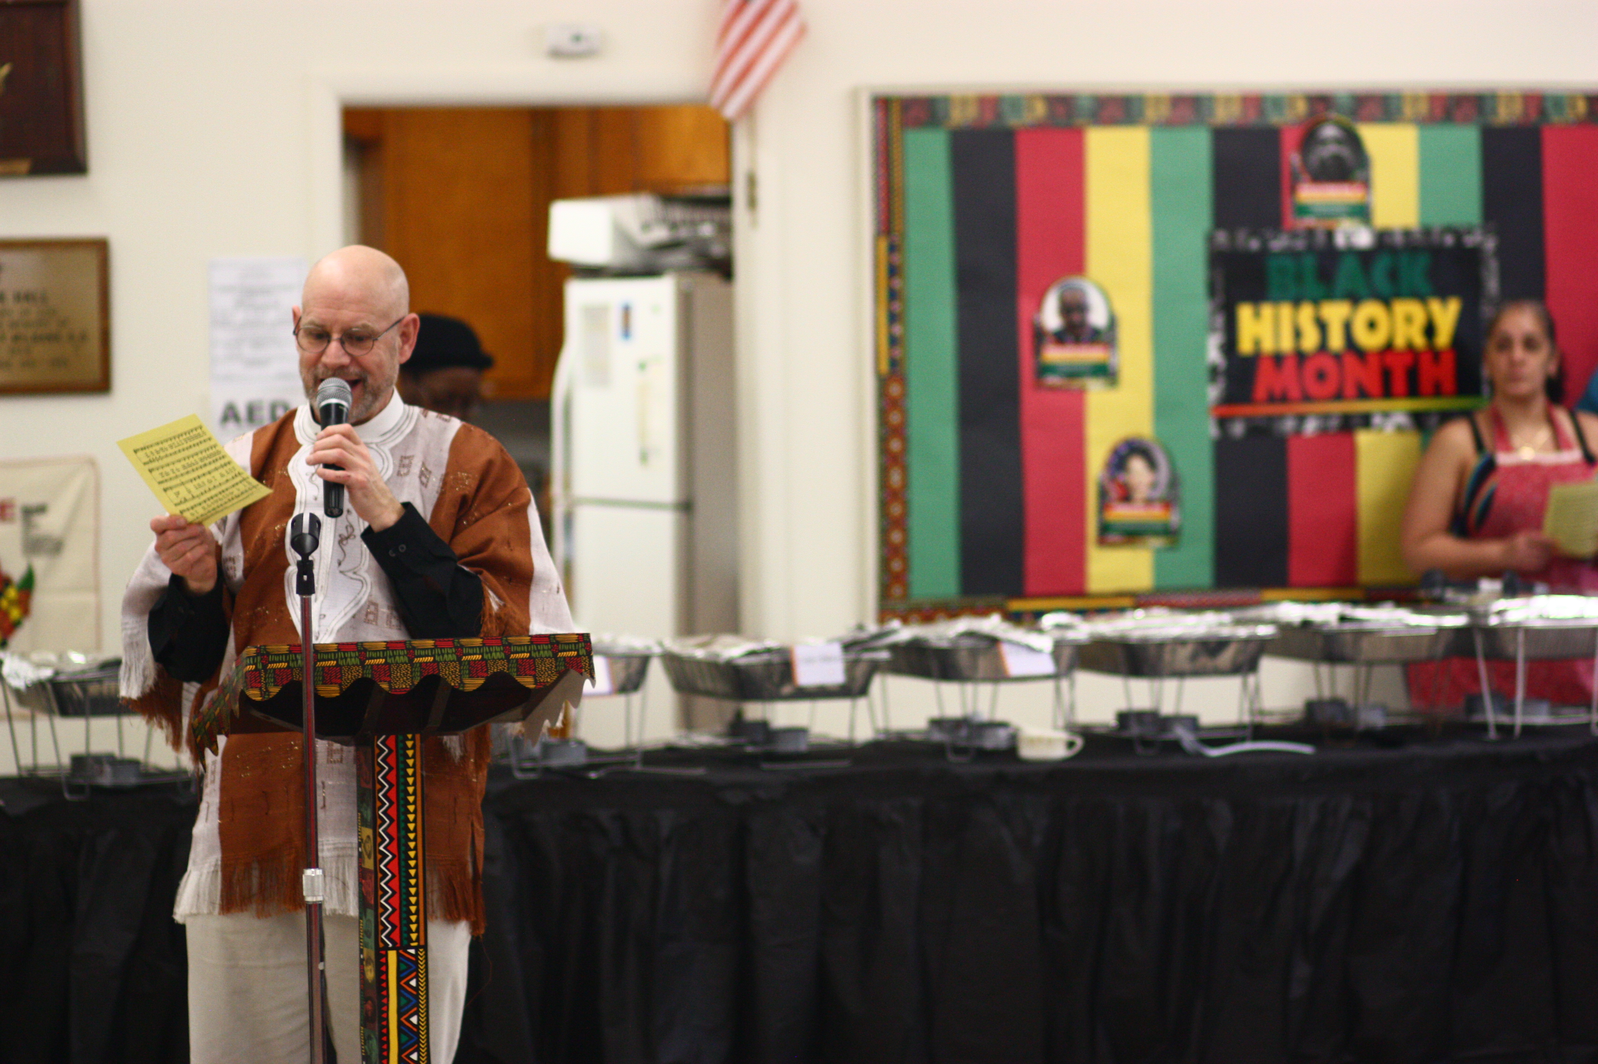
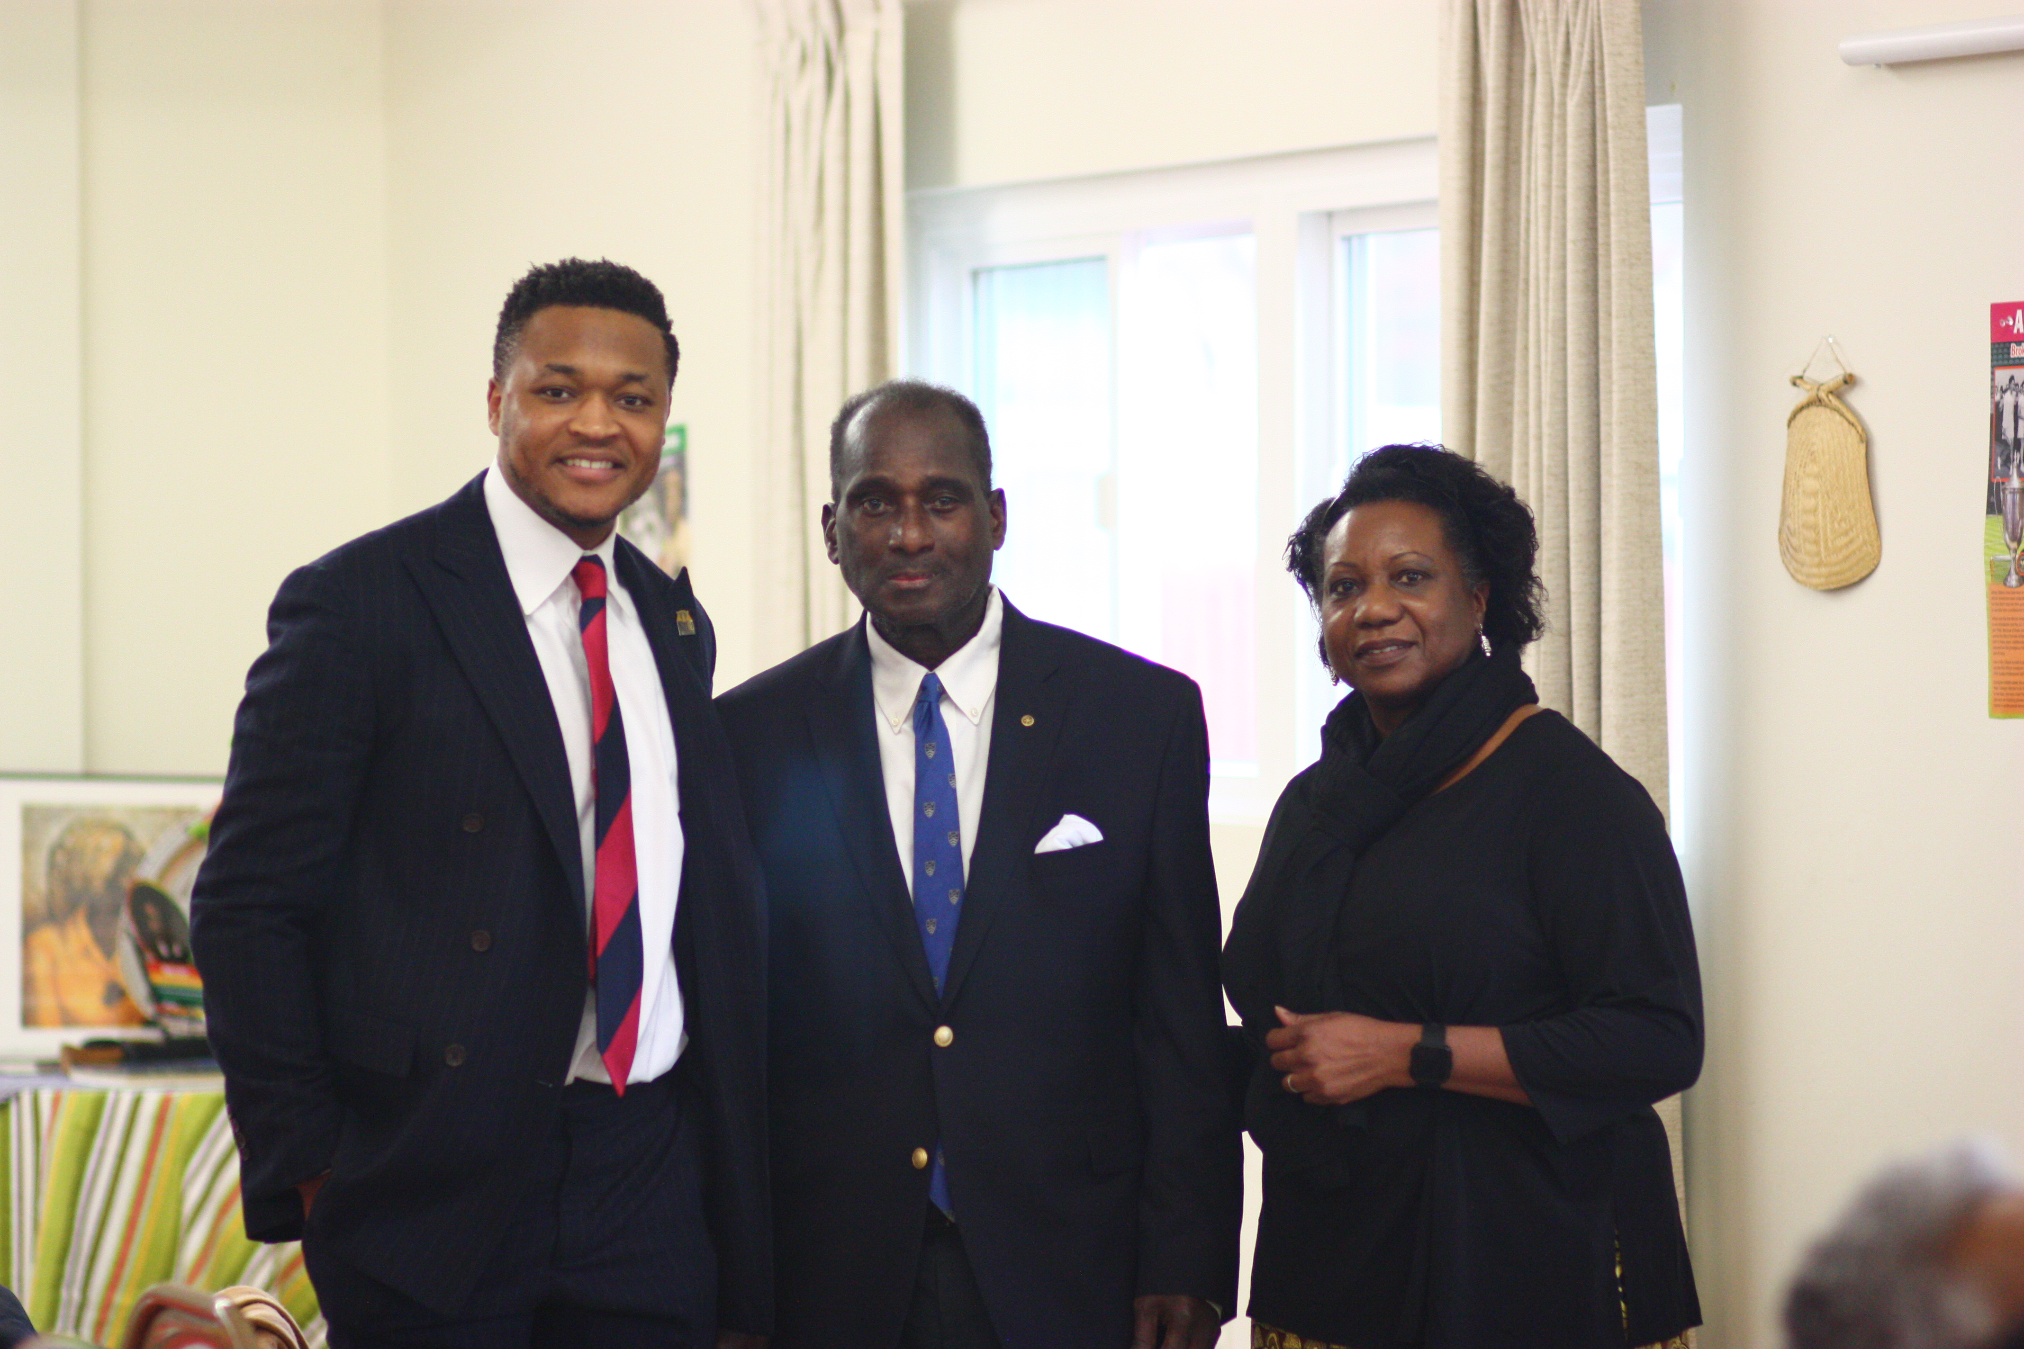
Looking Back: Highlights from our 2020 BHM Event

Slide 6
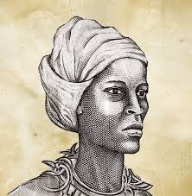
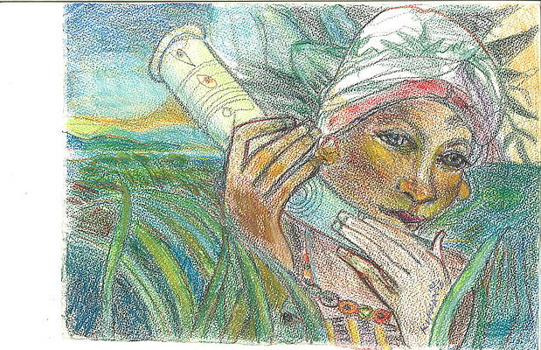
At last year’s event, Errol Maye told the gathering about the Maroons of Jamaica, people who had escaped enslavement and fought to end the evil of slavery.
Nanny of the Maroons, of royal African descent, formed a team who used their military skills to fight the English Army.
The Maroons communicated effectively over long distances with the Abeng, an instrument made from animal horn.
The English military eventually gave up and signed a treaty with the Maroons giving them good lands in the hills (on which they still don't pay taxes!)
Their choice of food in the hills was jerk pork from wild pigs which remains popular with Jamaicans and tourists alike.
Nanny of the Maroons

Slide 7
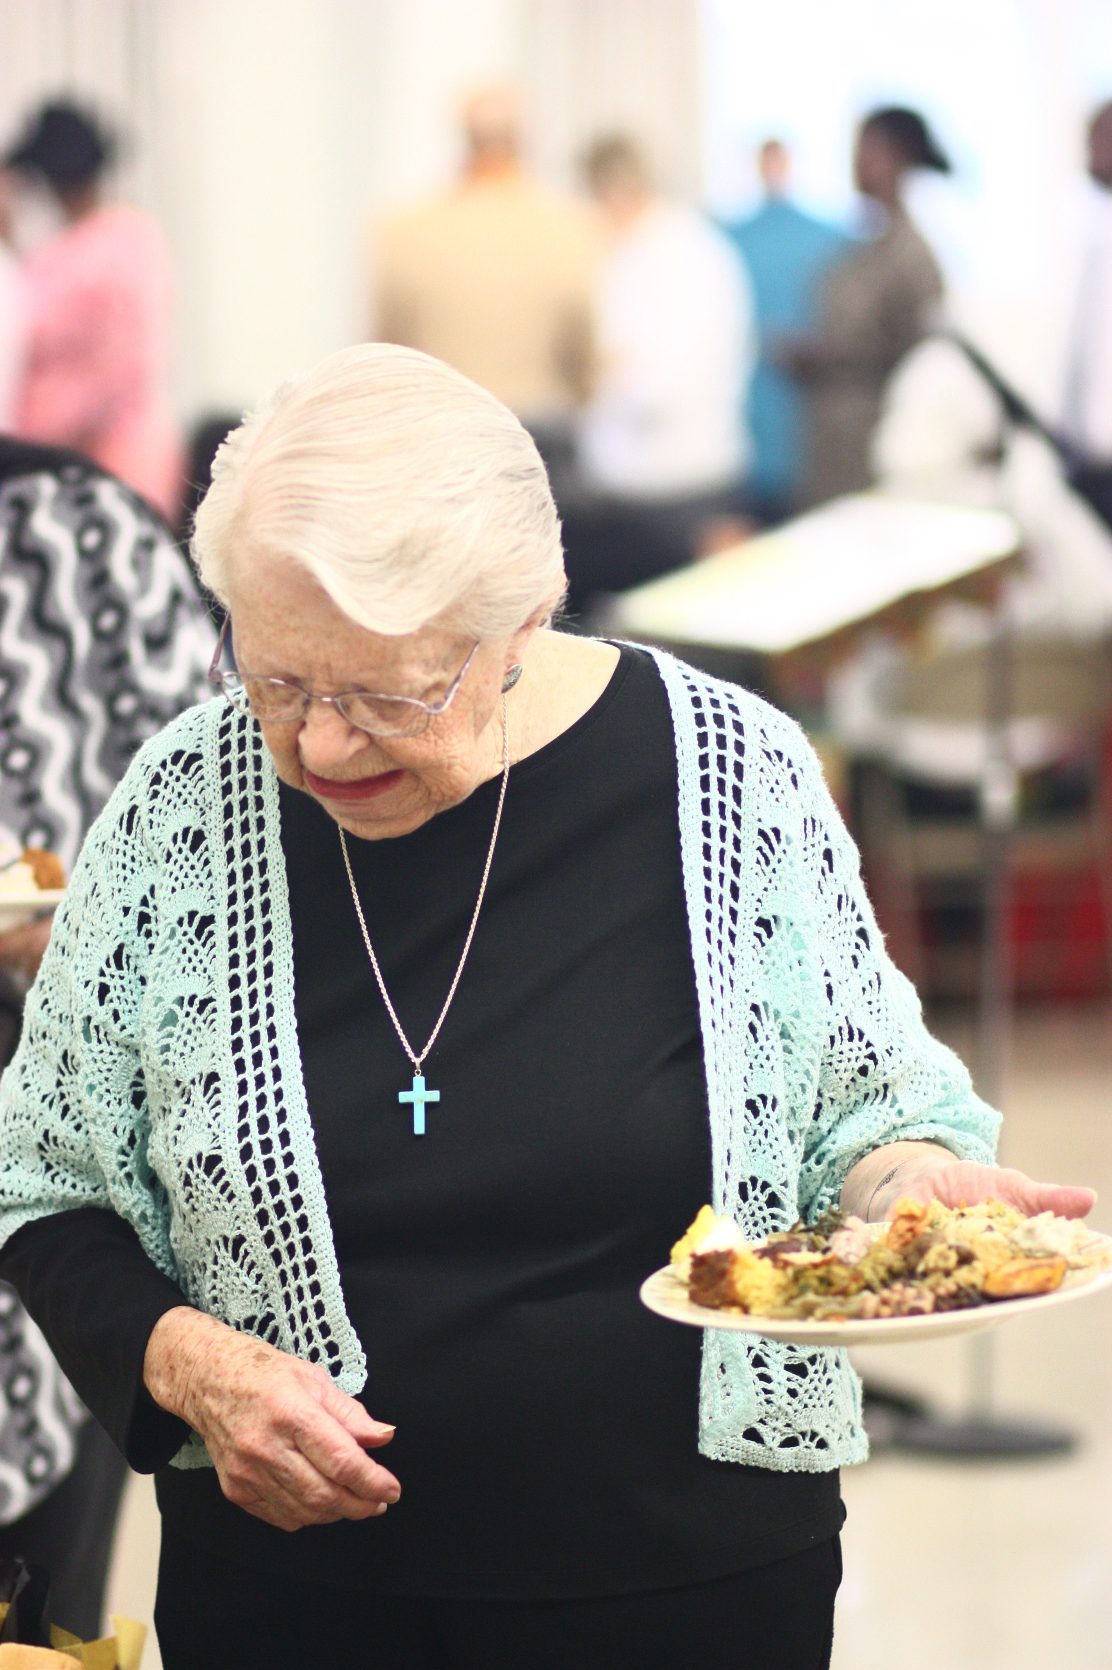
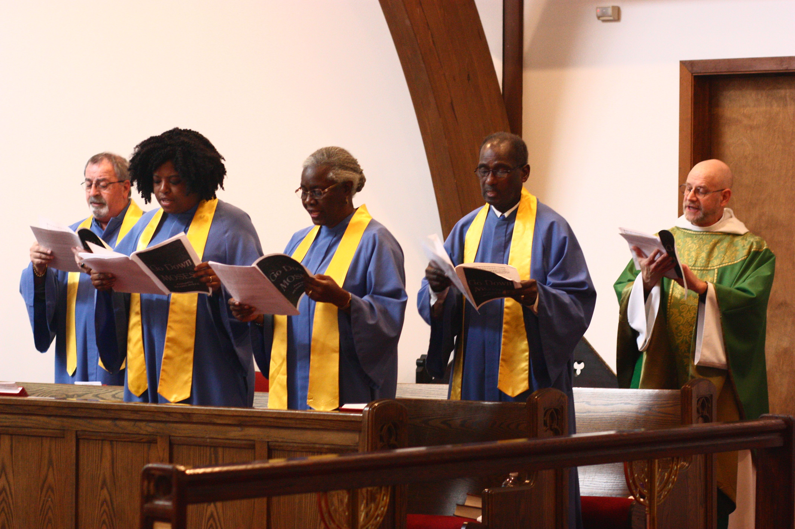
Looking Back: Highlights from our 2020 BHM Event

Slide 8
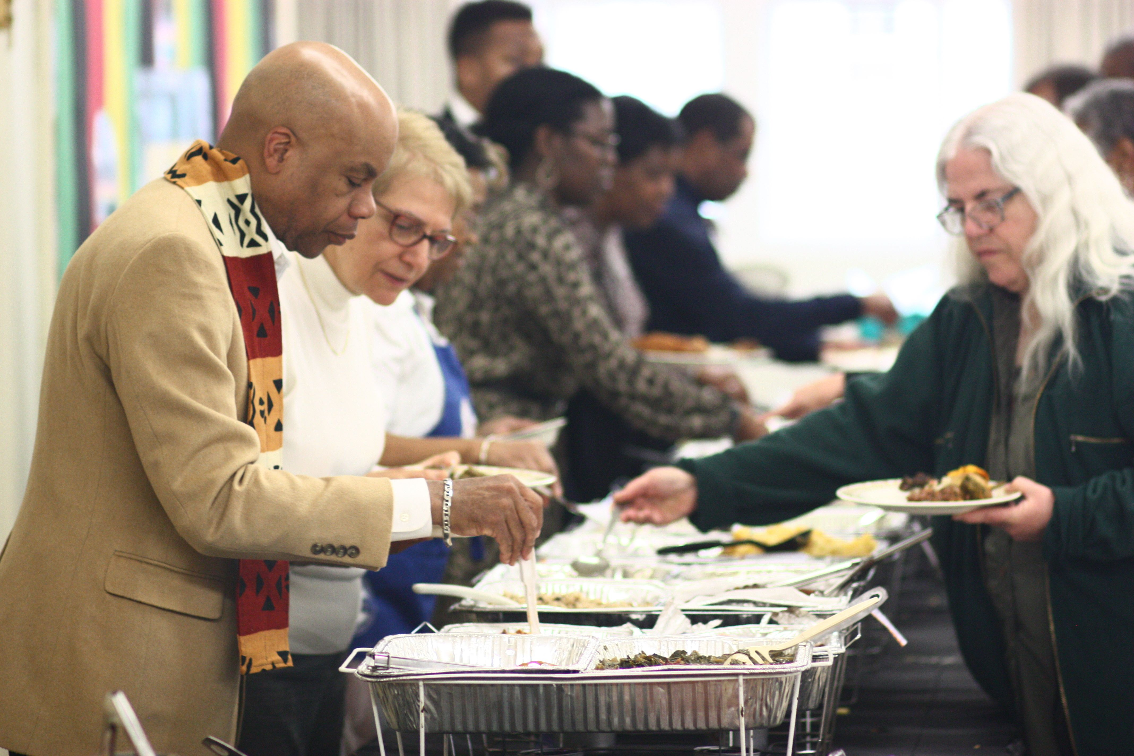
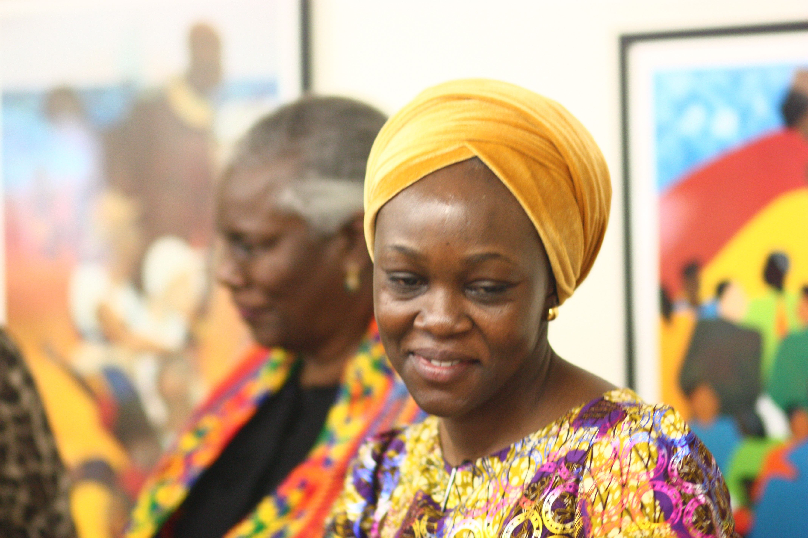
Looking Back: Highlights from our 2020 BHM Event

Slide 9
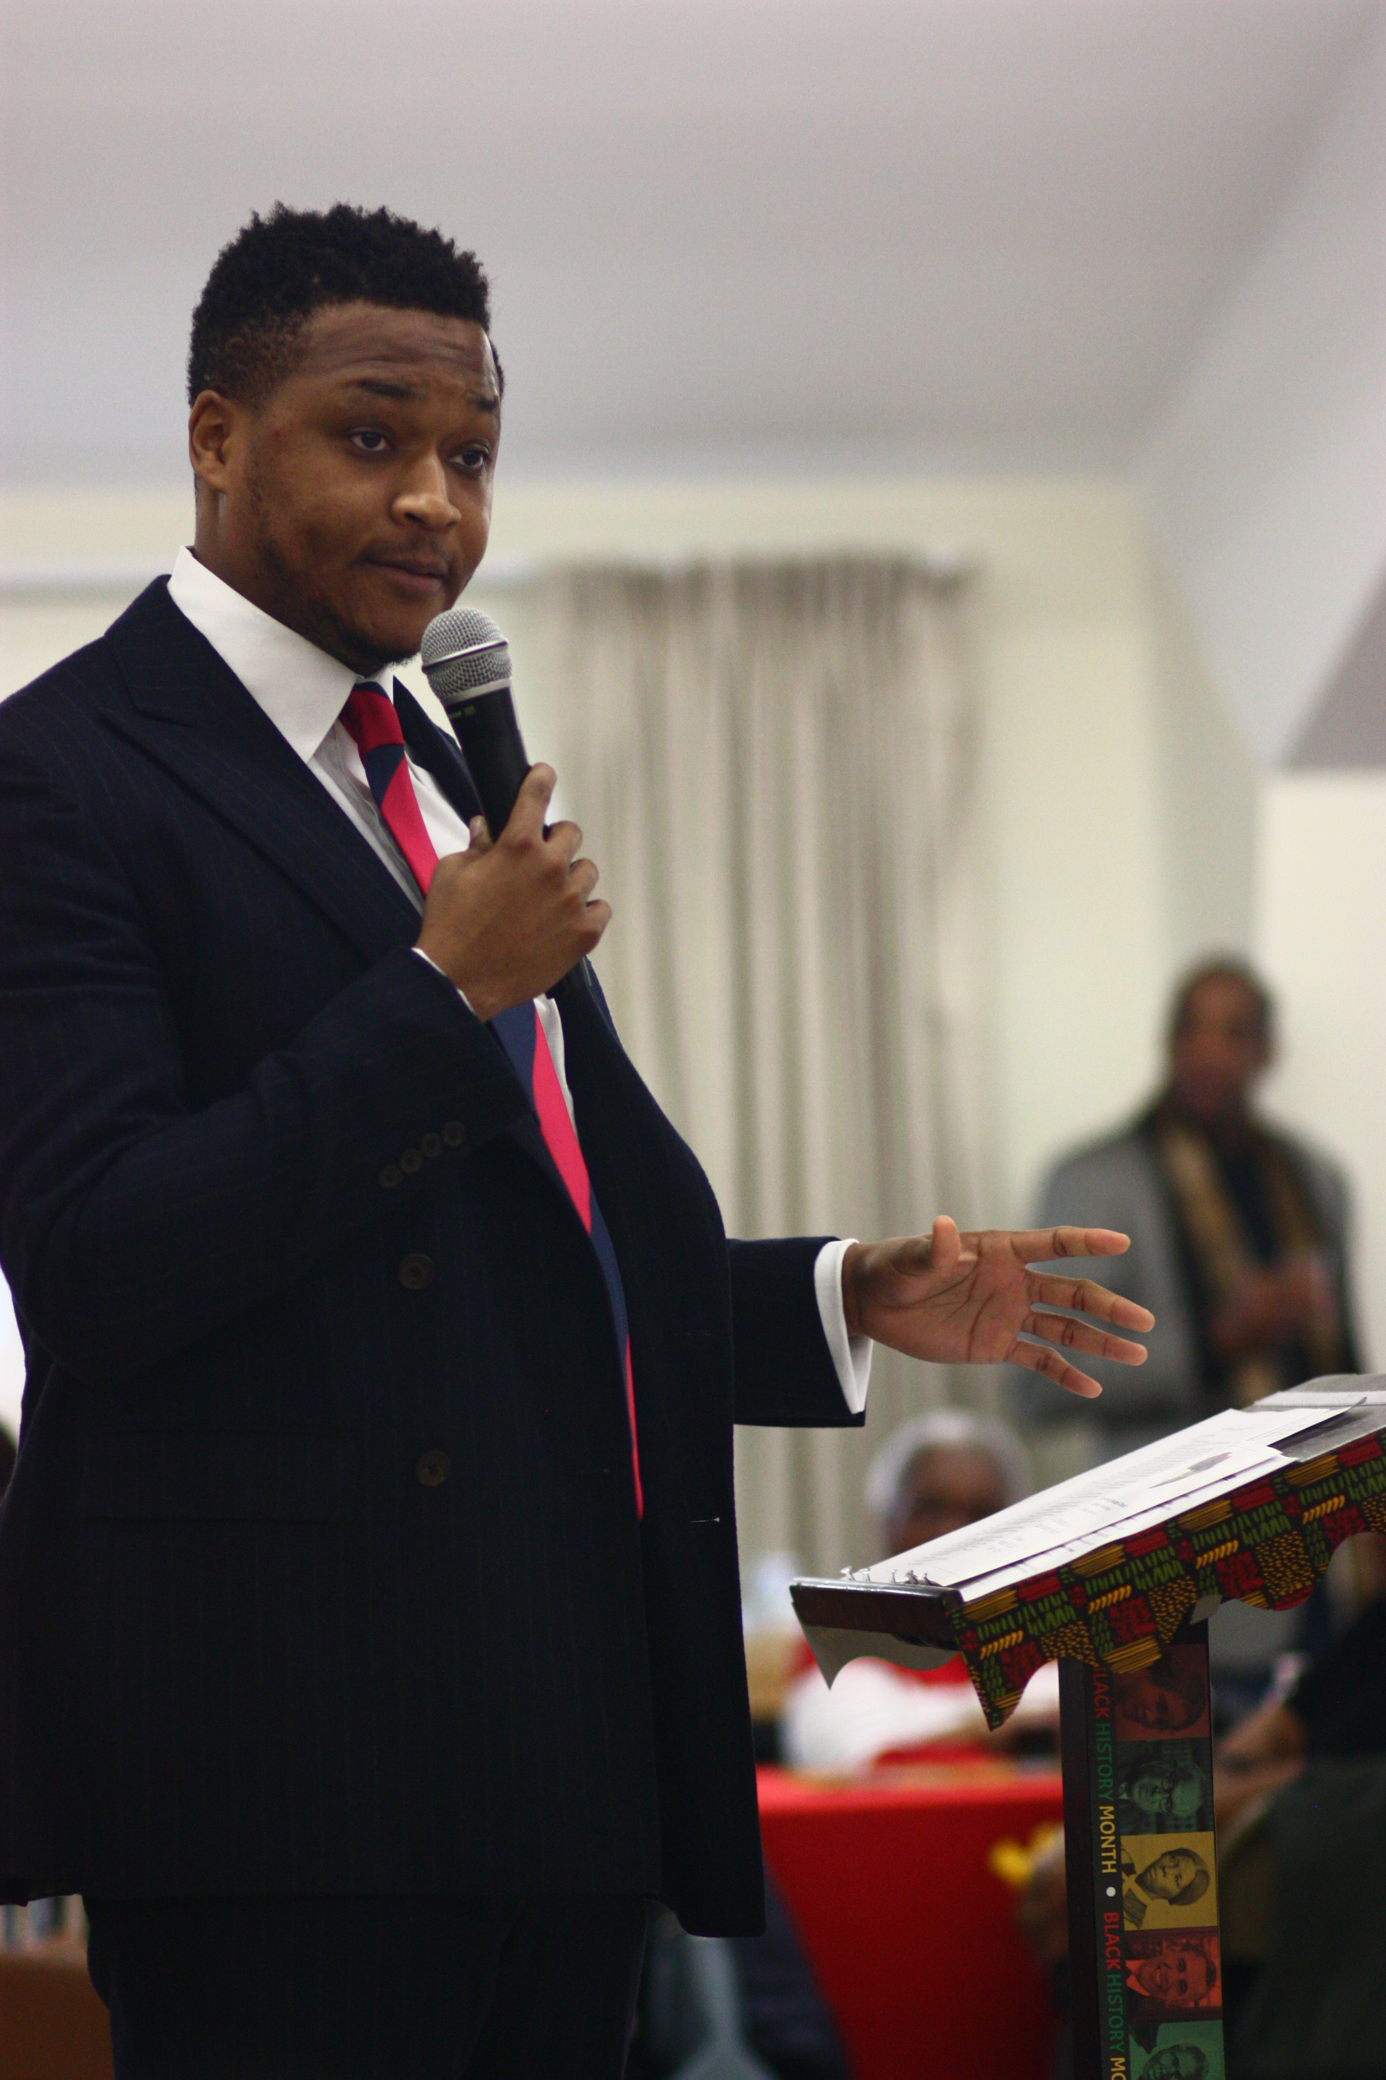
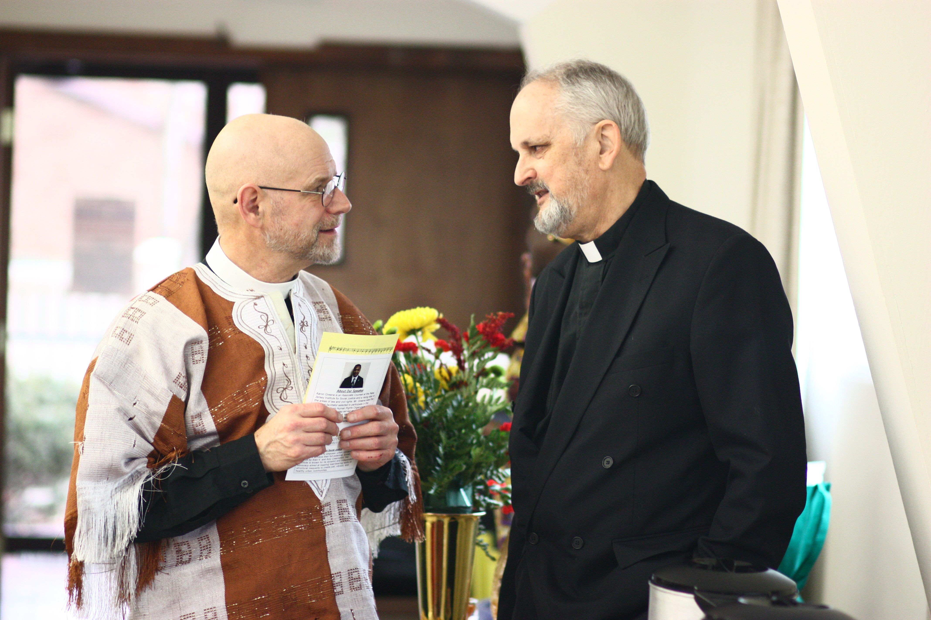
Looking Back: Highlights from our 2020 BHM Event

Slide 10
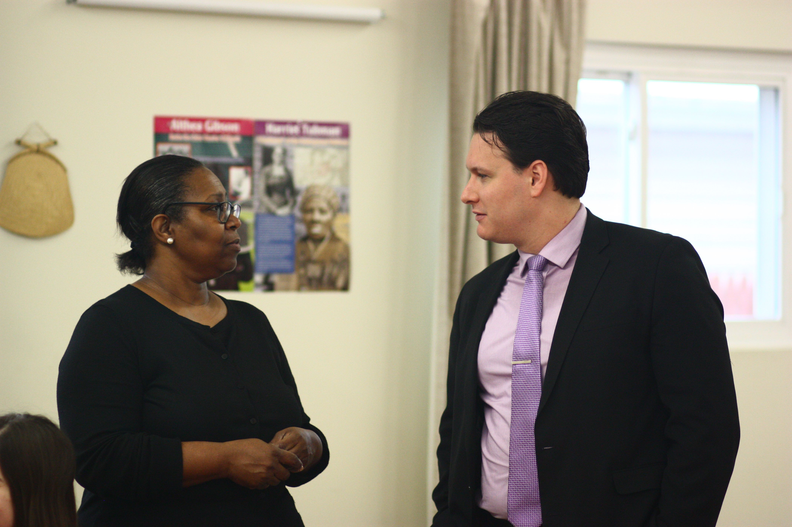
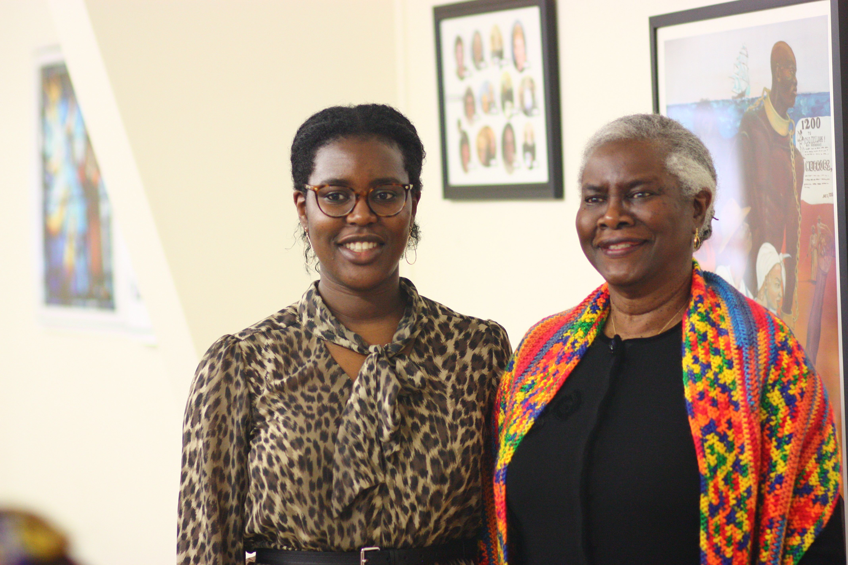
Looking Back: Highlights from our 2020 BHM Event

Slide 11
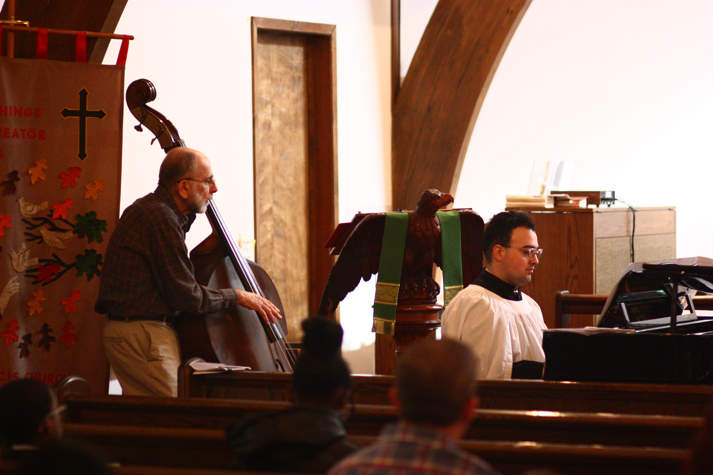
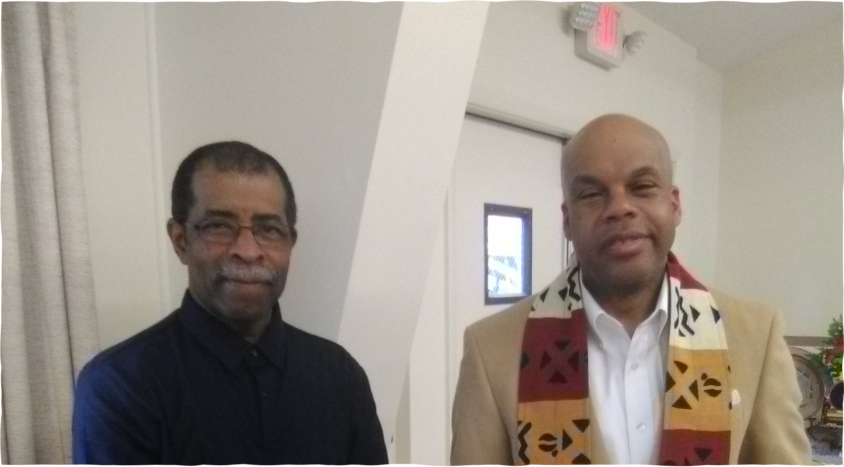
Looking Back: Highlights from our 2020 BHM Event

Slide 12
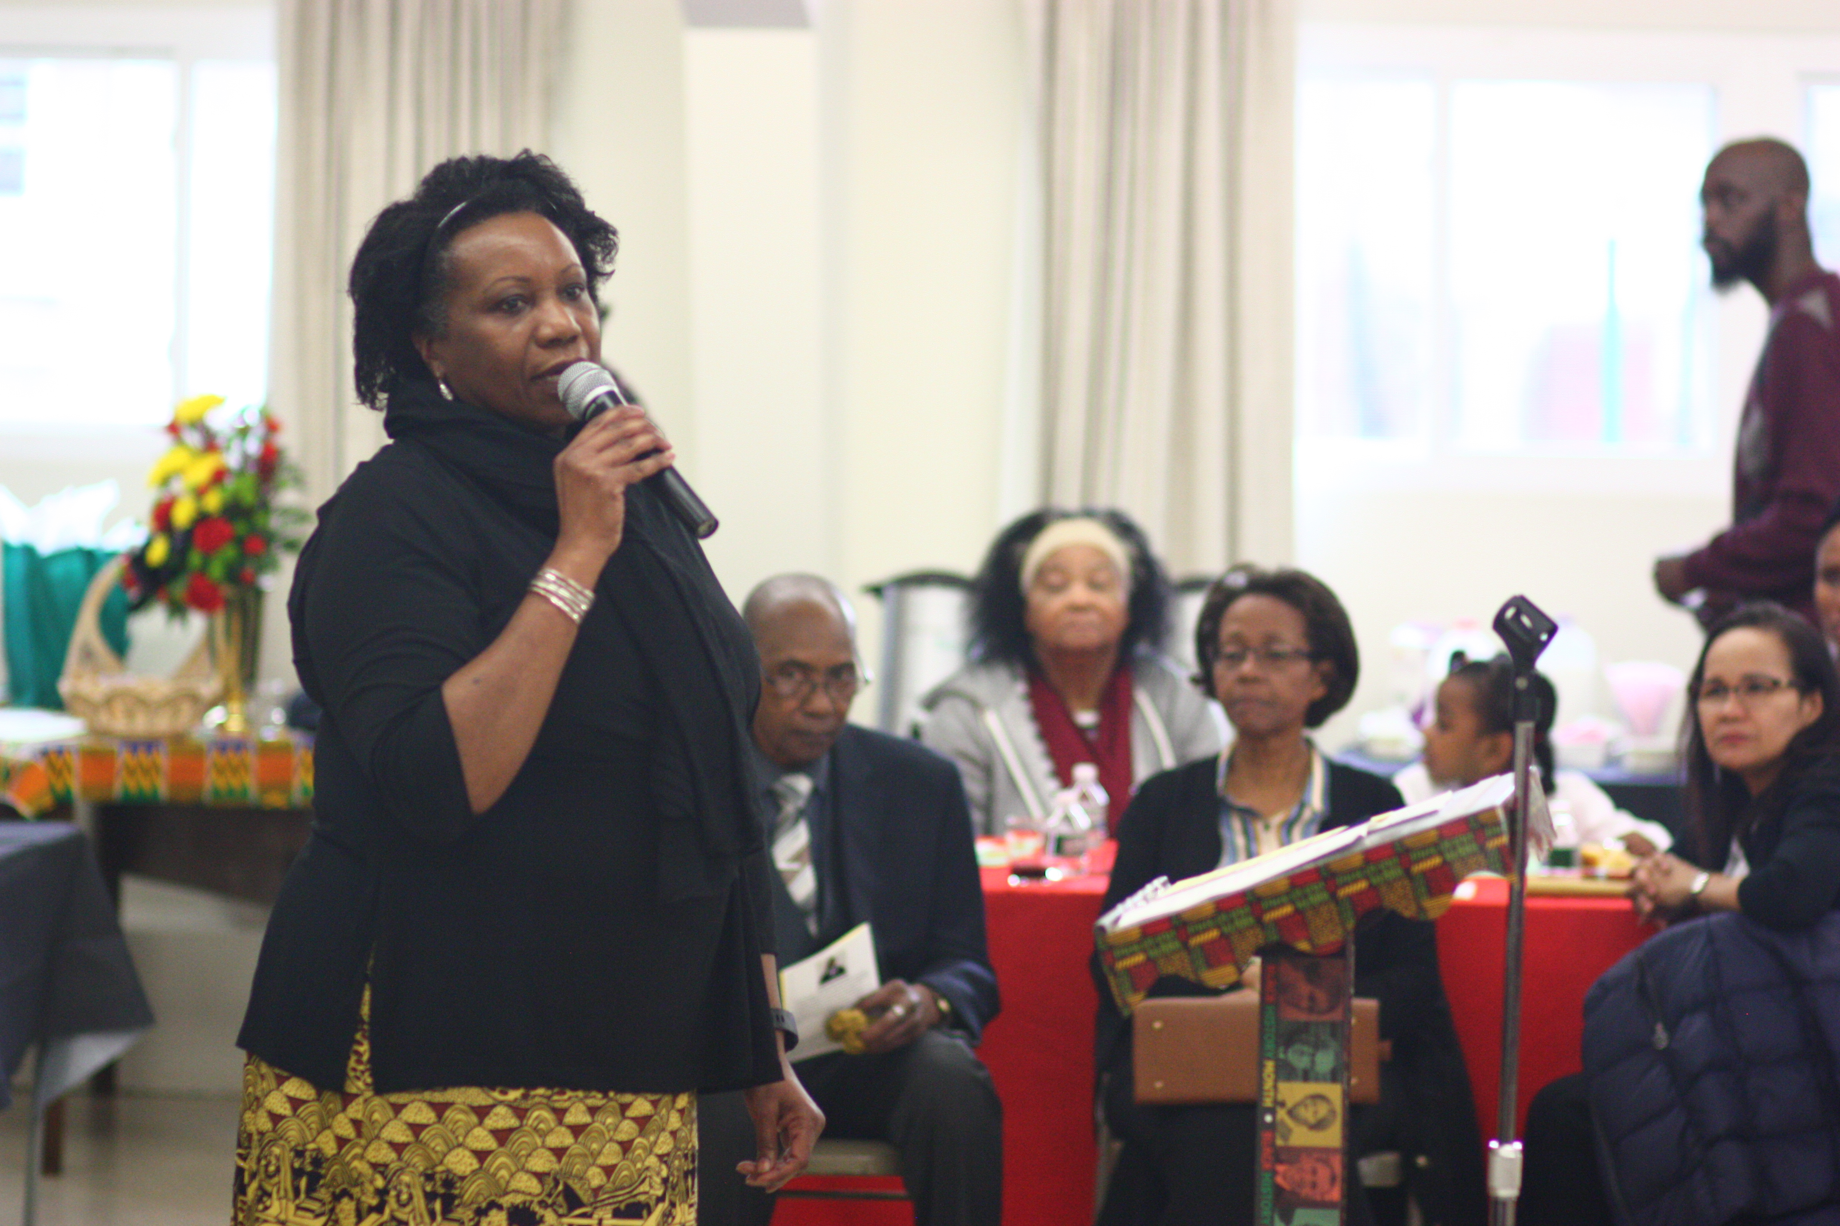
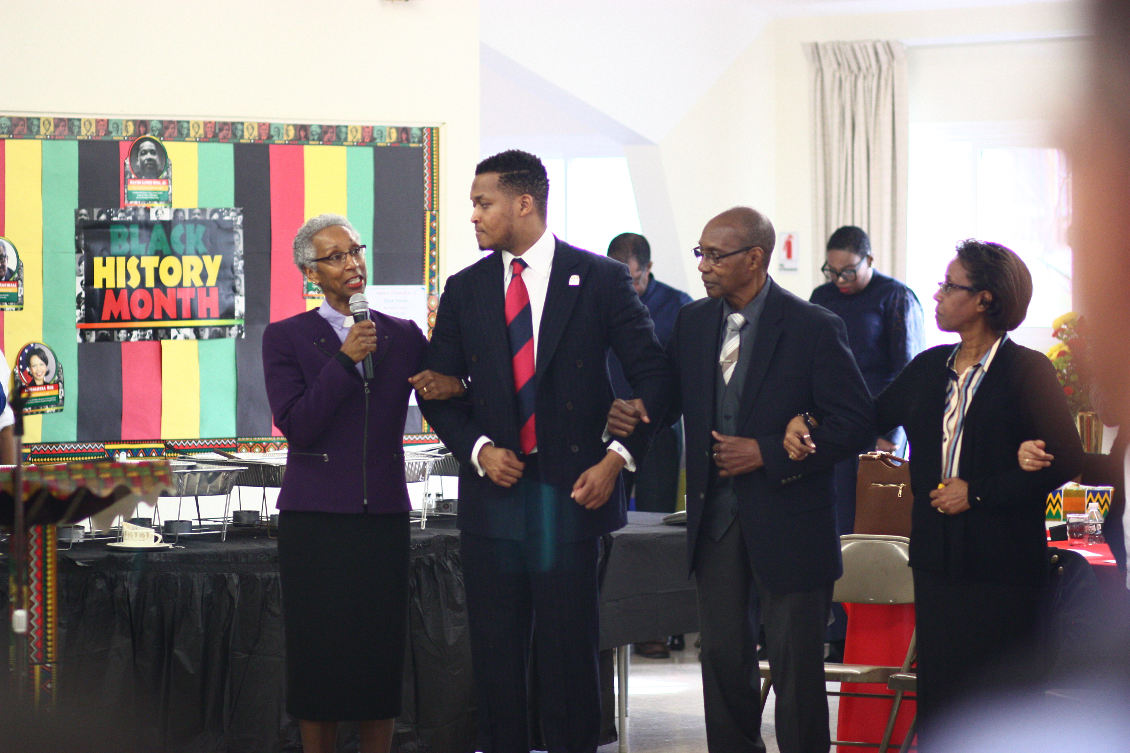
Looking Back: Highlights from our 2020 BHM Event

Slide 13
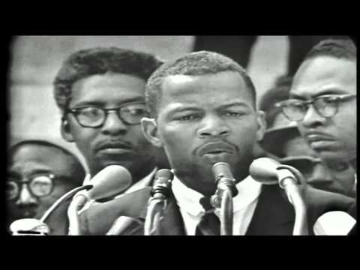
Good Trouble - March on Washington Speech Clip August 28, 1963
U.S. Representative John Lewis
1940-2020

Slide 15
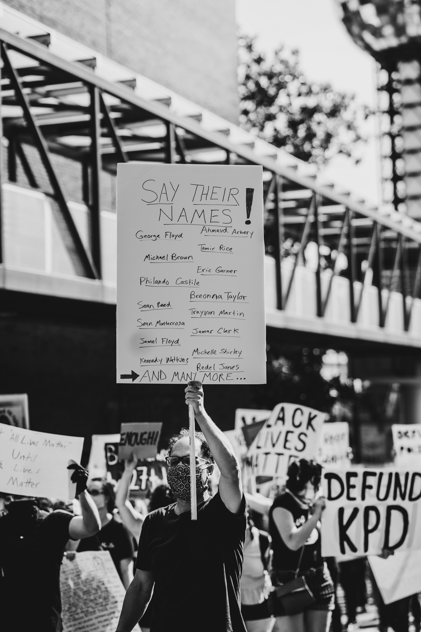
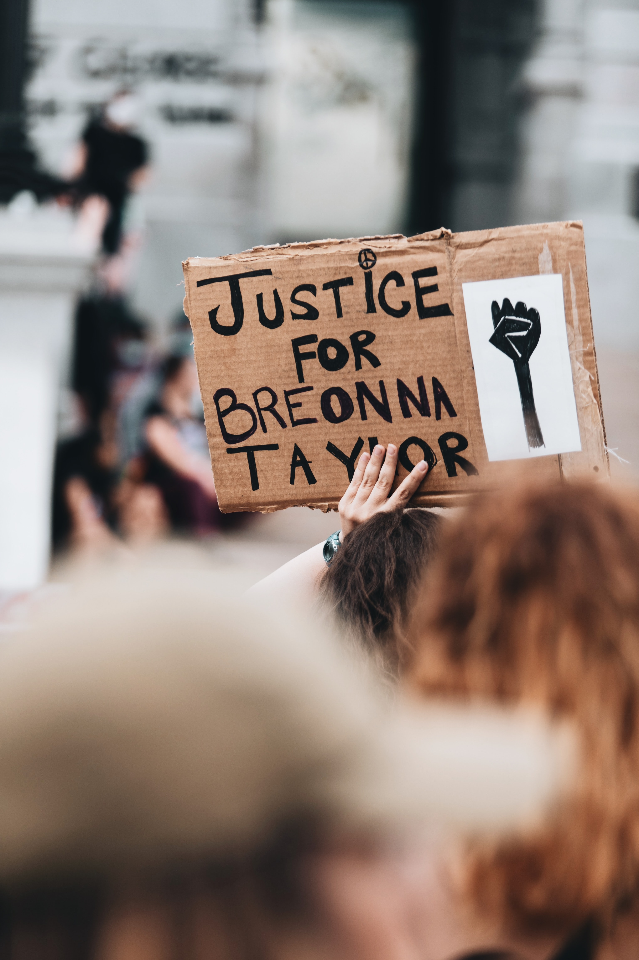
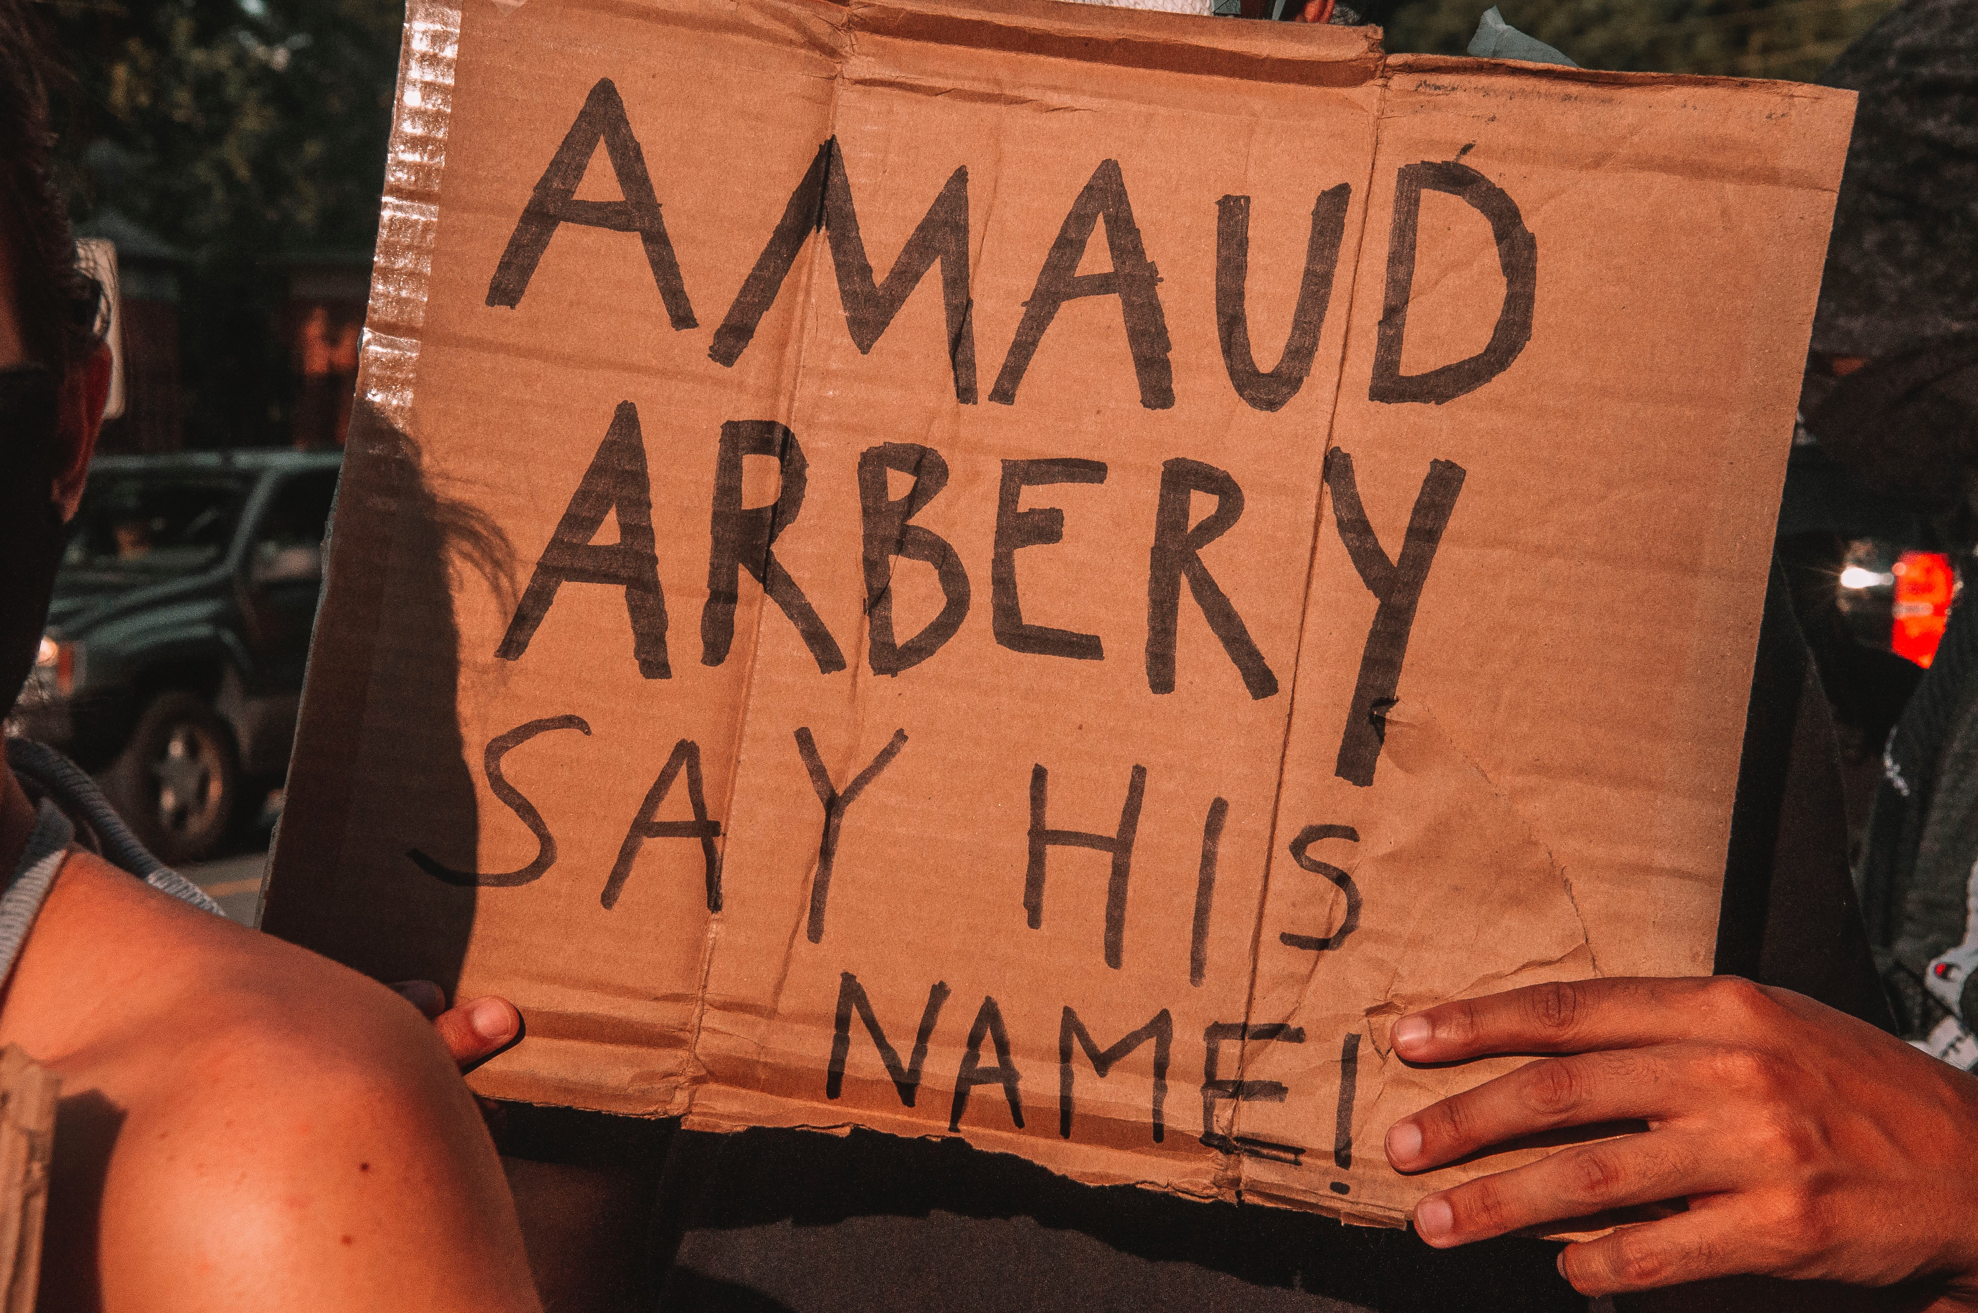
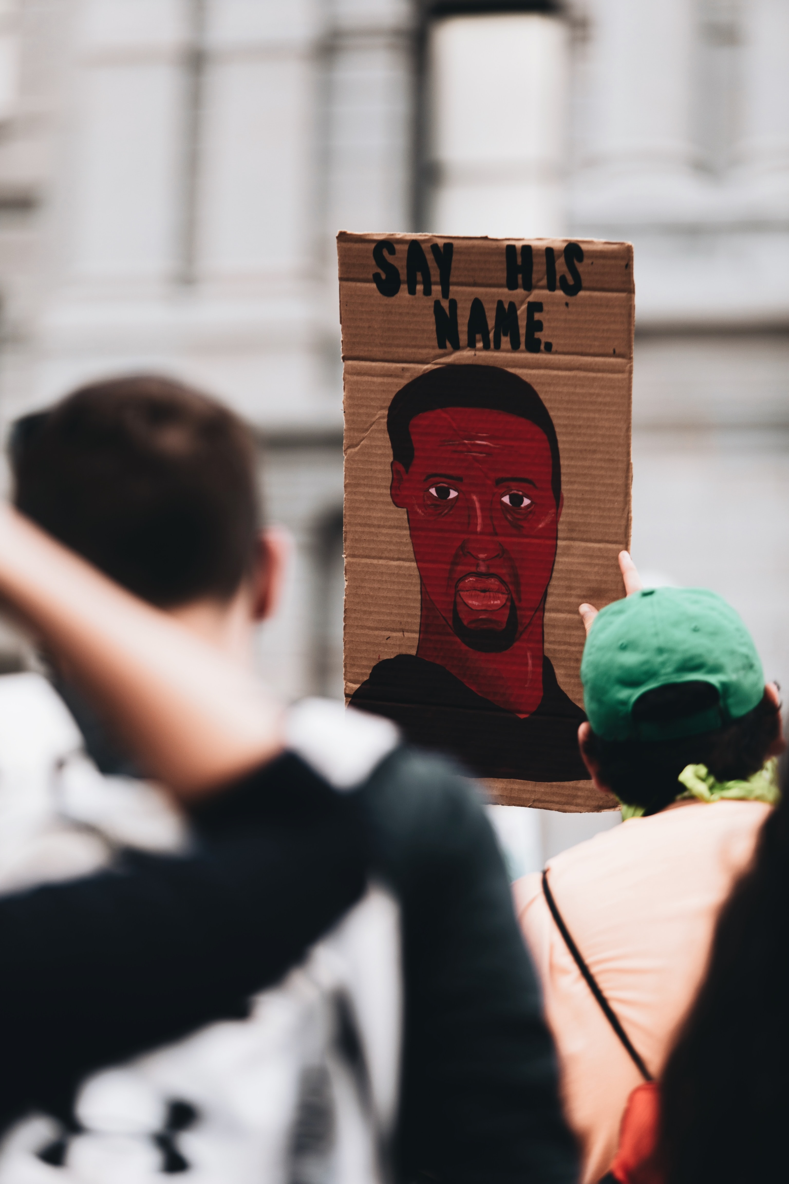

Slide 16
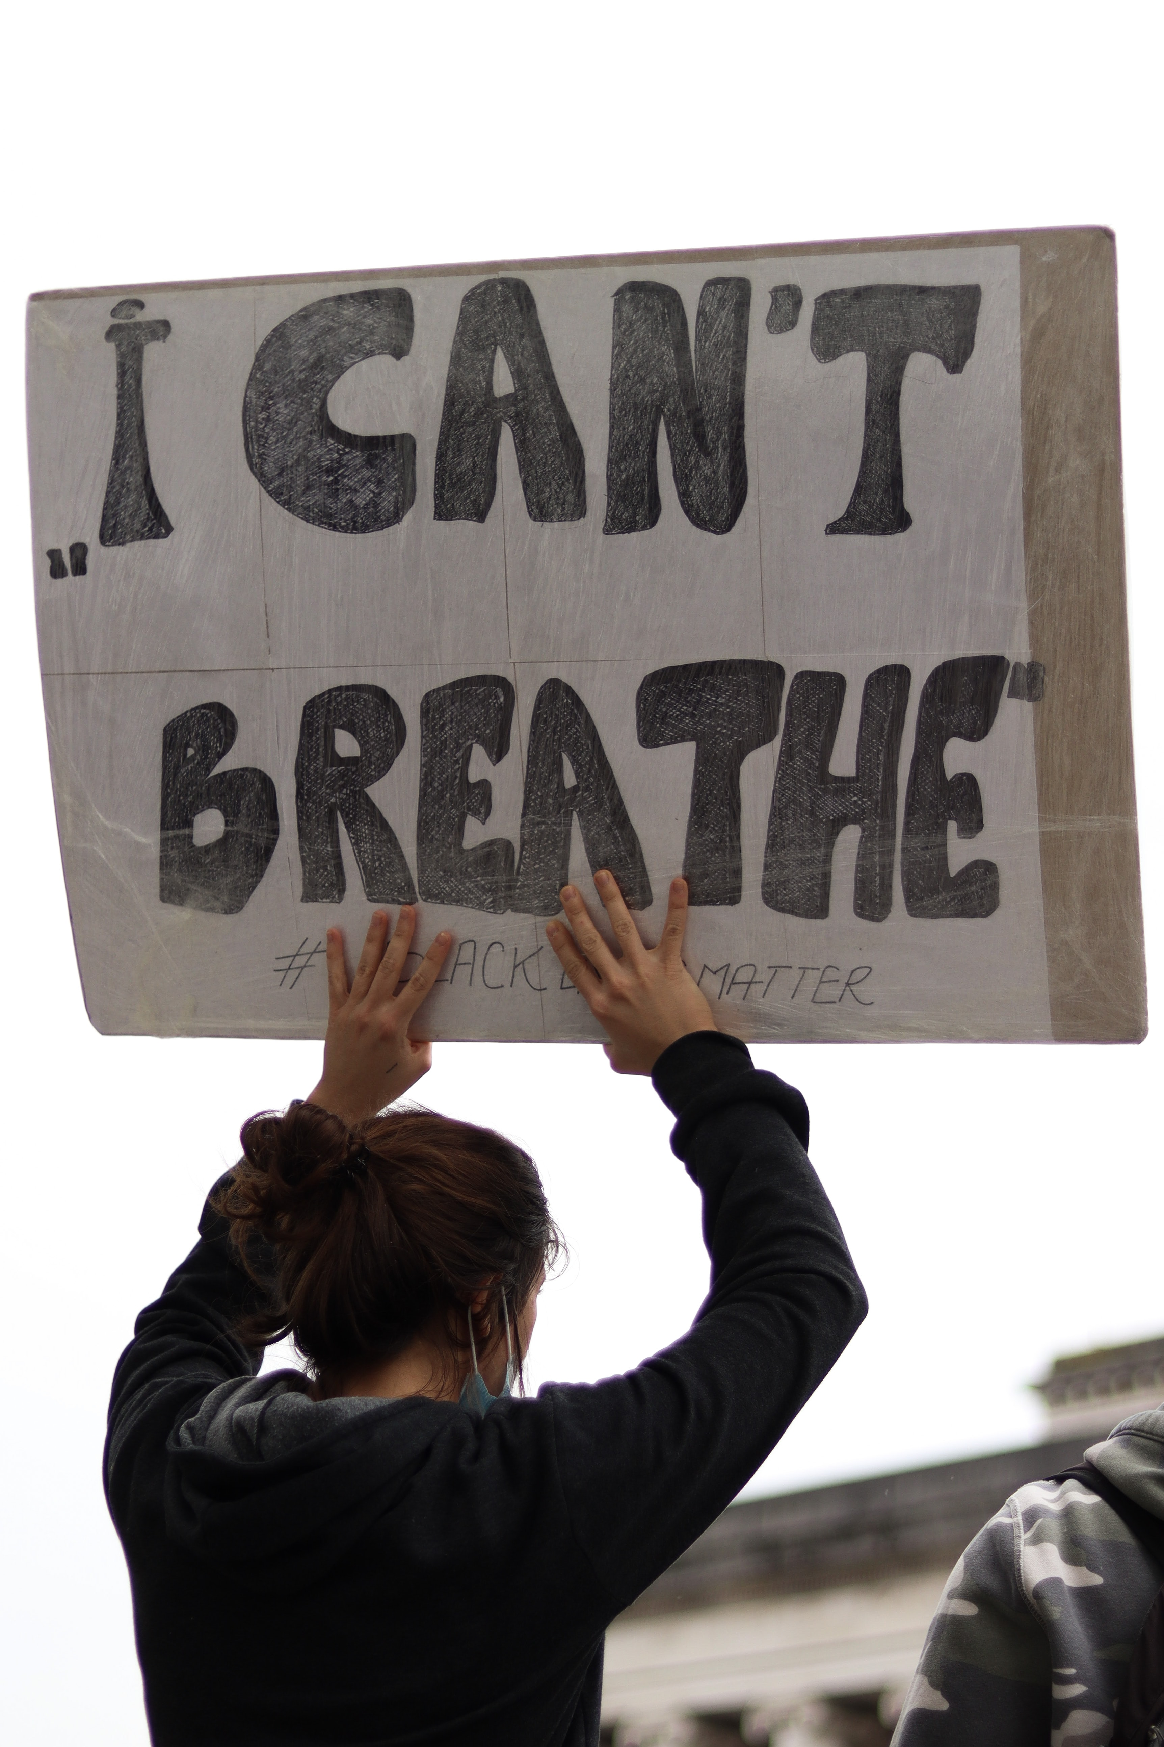
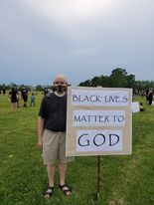
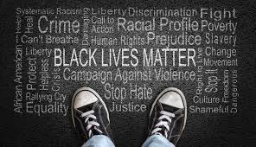

Slide 17
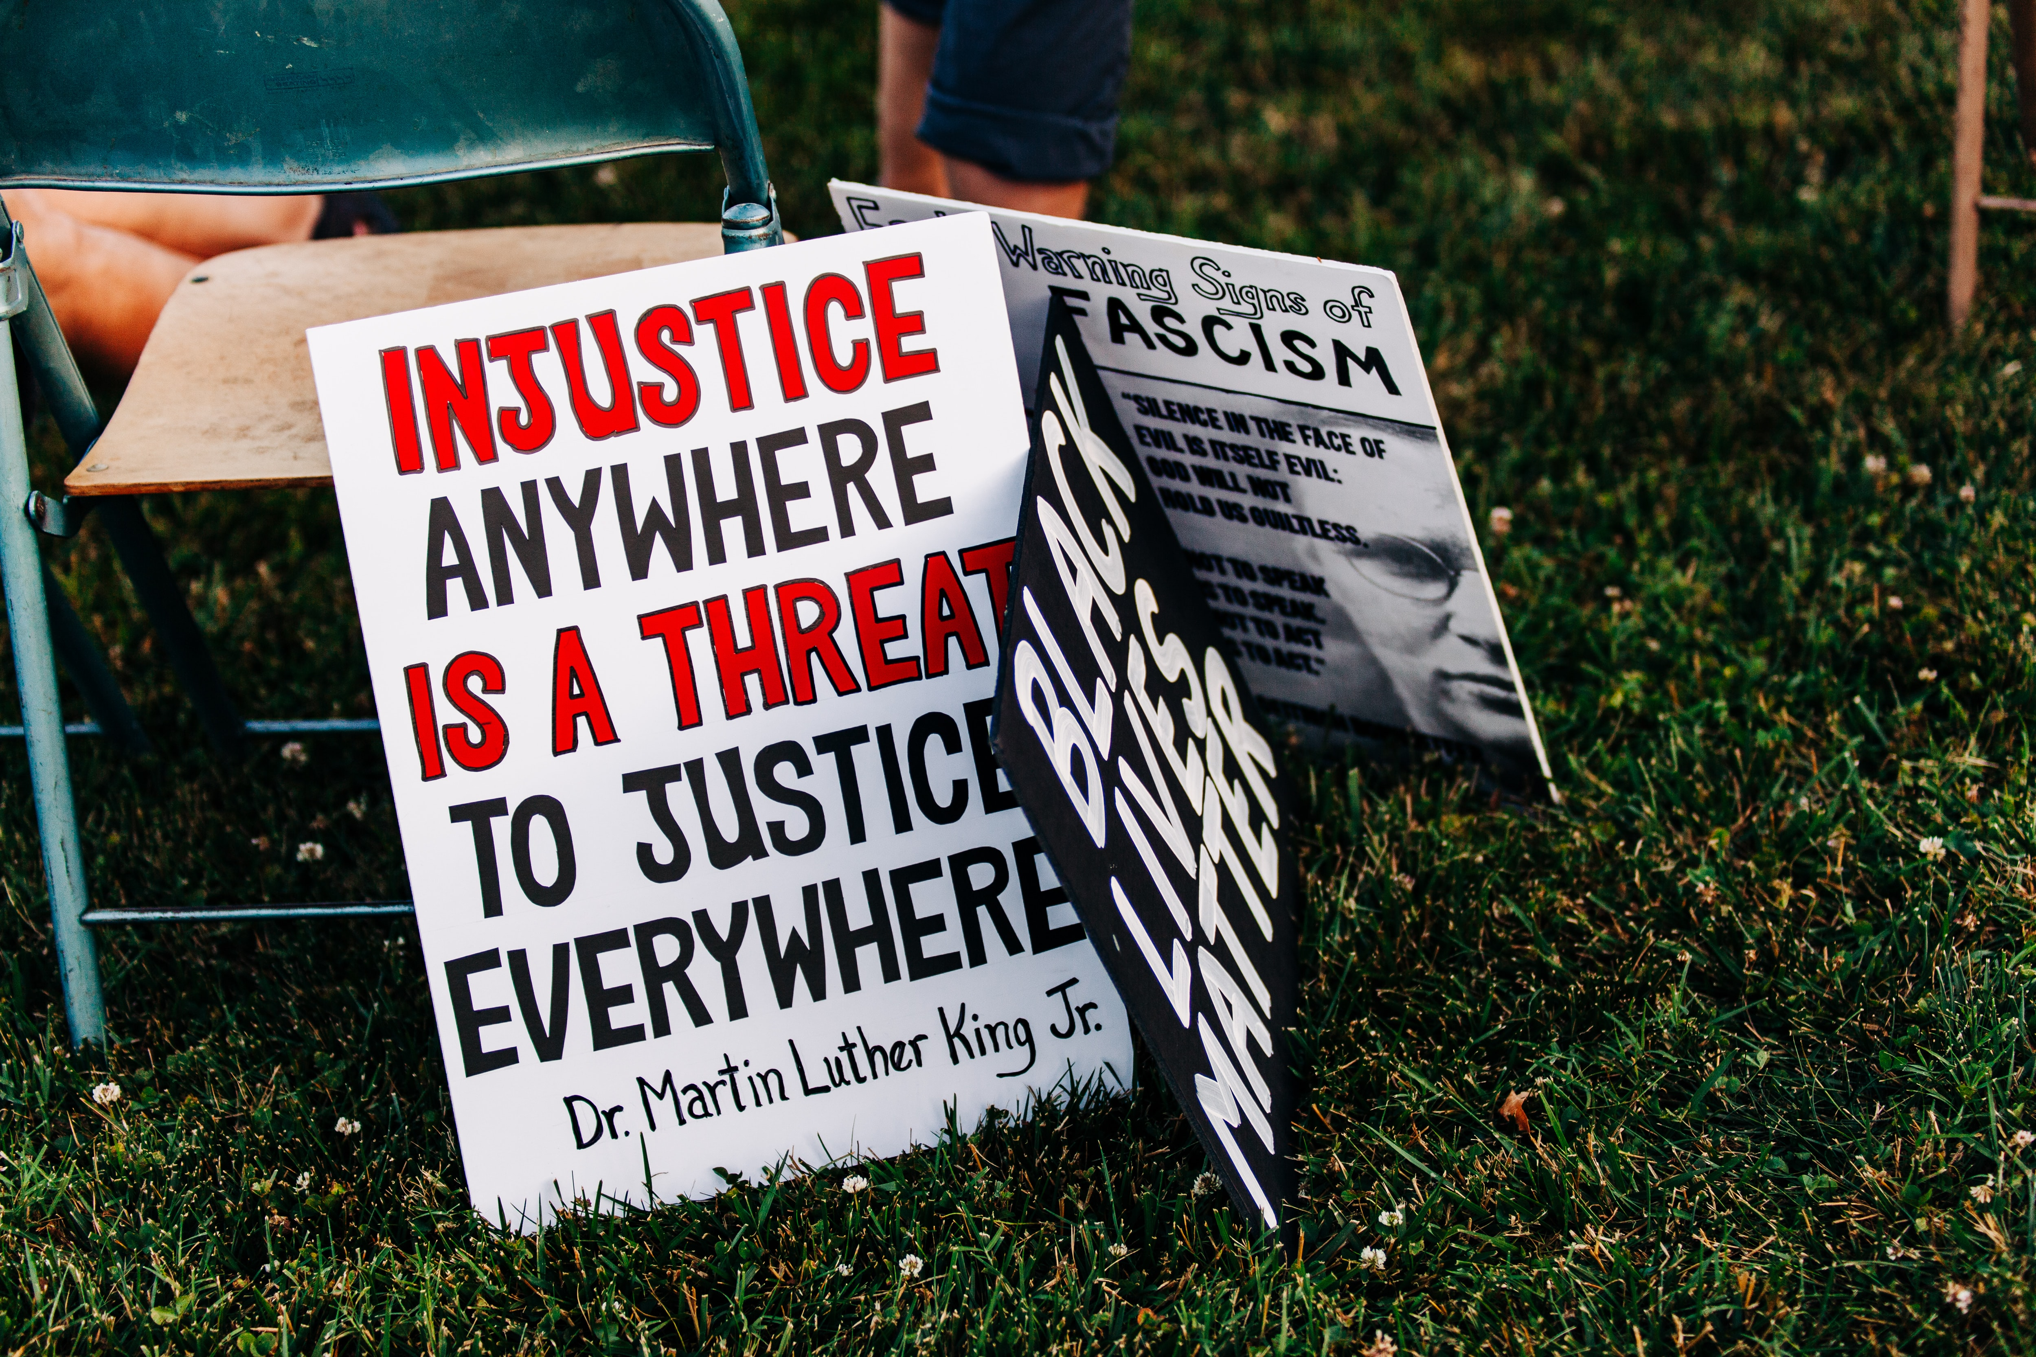
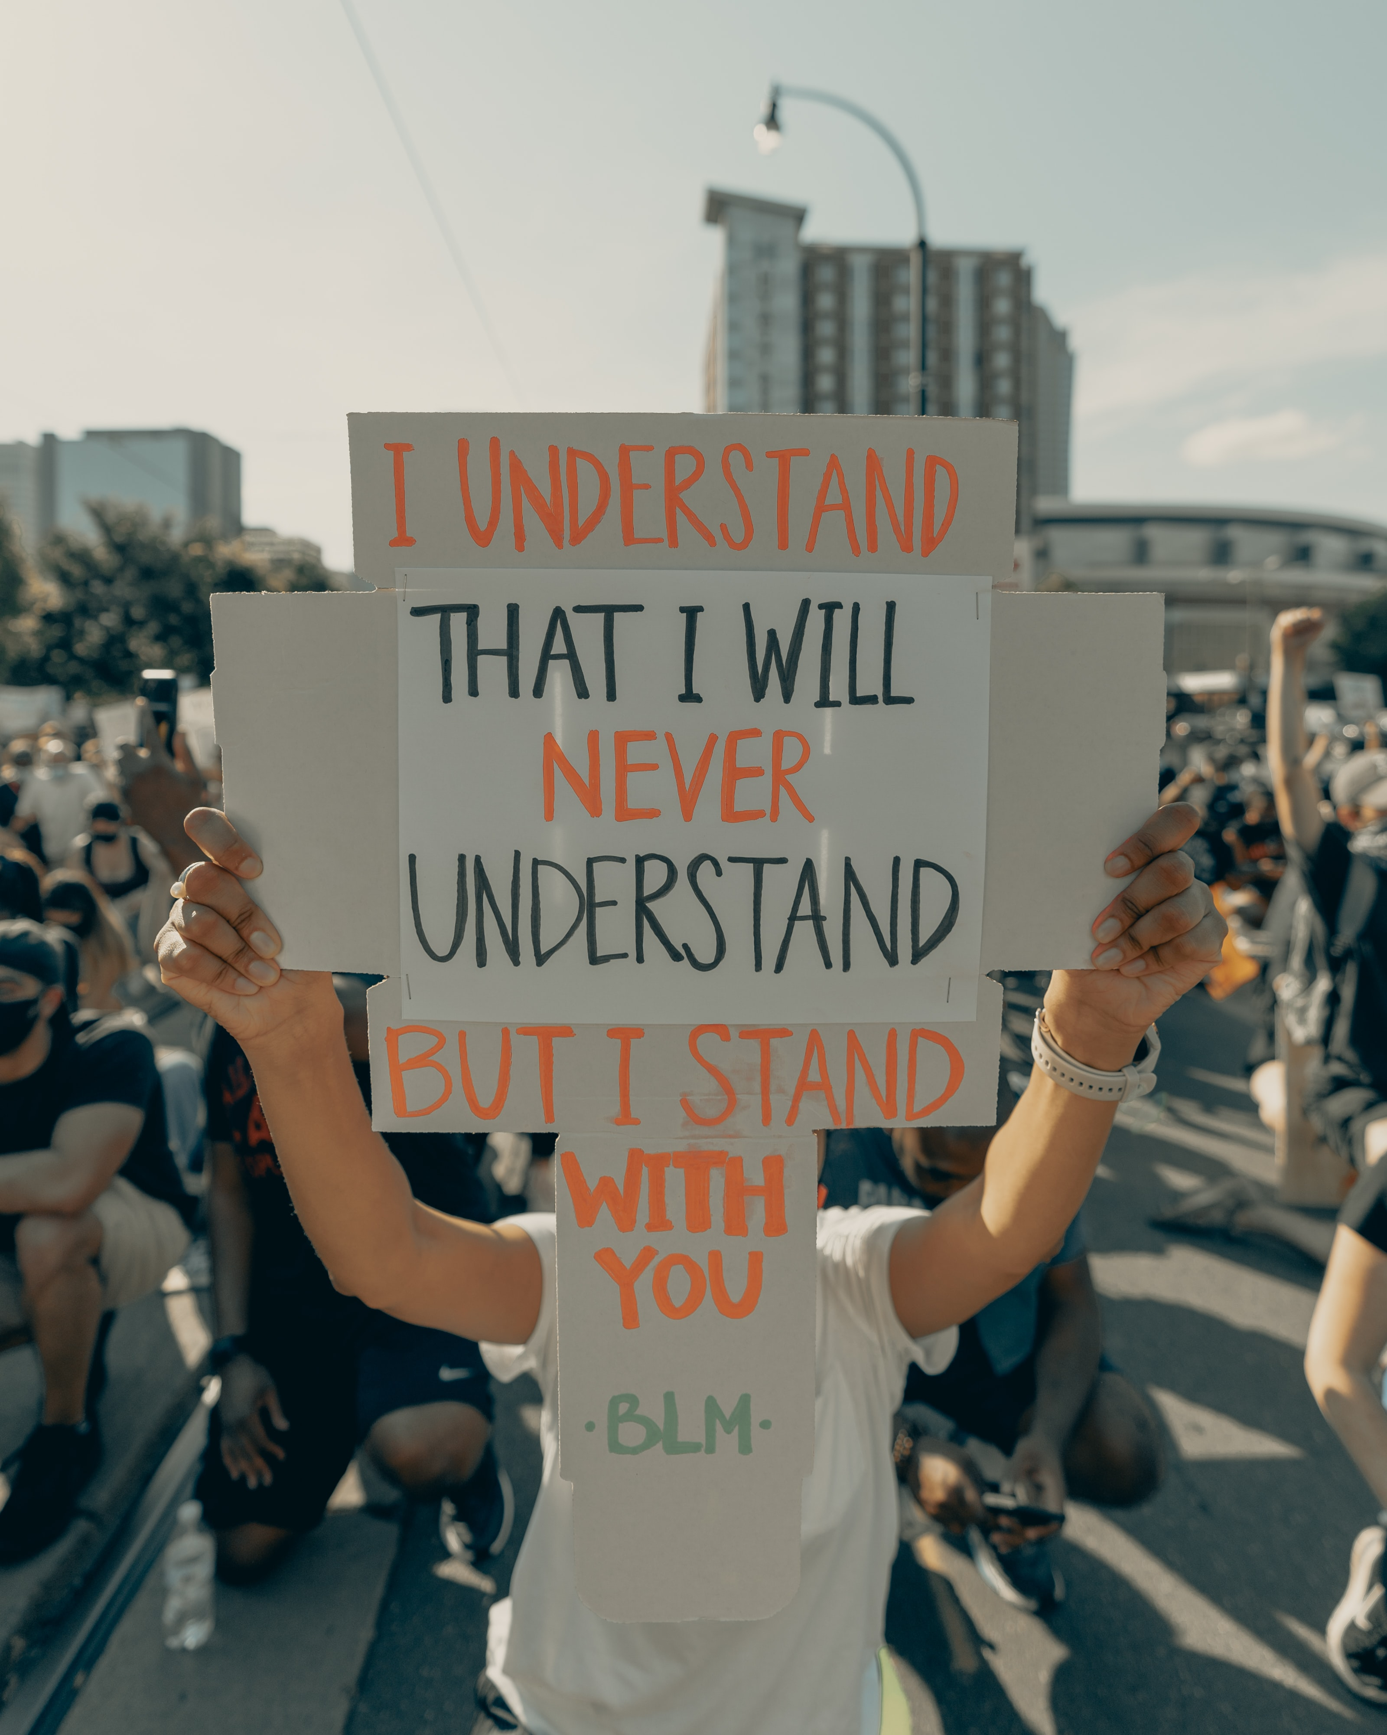
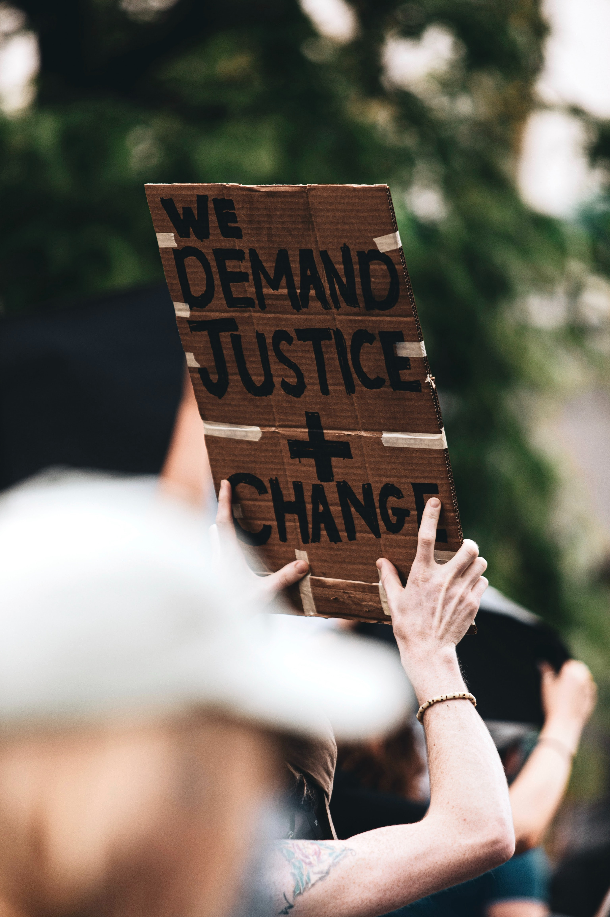
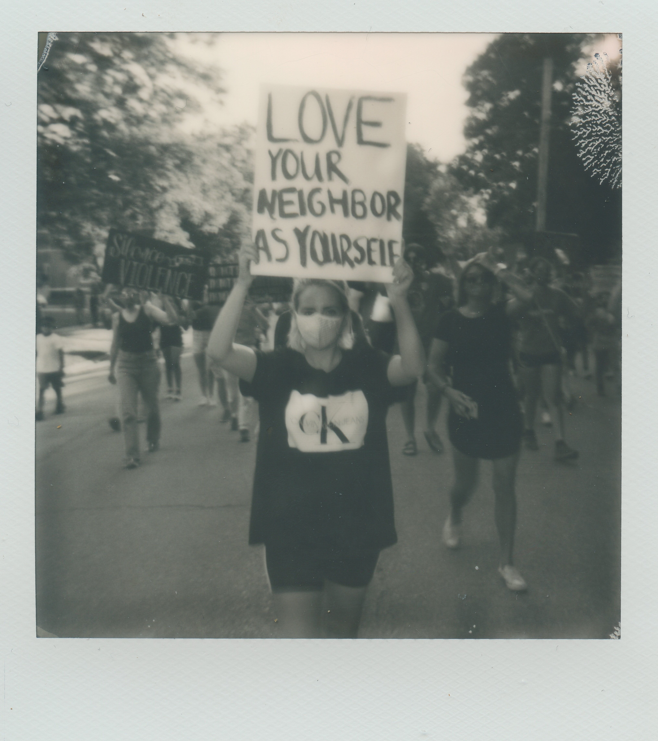

Slide 18
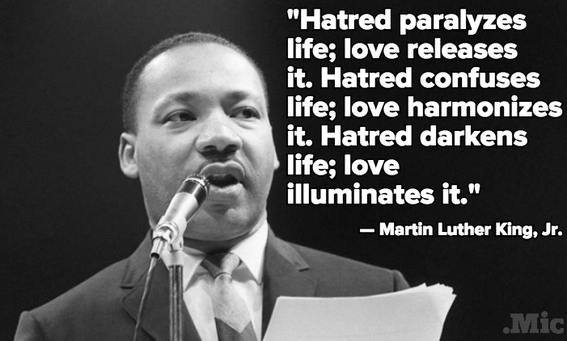
Conclusion
Dr. Martin Luther King, Jr.
1929-1968

Slide 19
Words of Wisdom: Dr. Martin Luther King, Jr.
“Every man must decide whether he will walk in the light of creative altruism or in the darkness of destructive selfishness.”
“We must use time creatively, in the knowledge that the time is always ripe to do right.”
“Science investigates; religion interprets. Science gives man knowledge, which is power; religion gives man wisdom, which is control. Science deals mainly with facts; religion deals mainly with values. The two are not rivals.”
“There comes a time when one must take a position that is neither safe nor politic nor popular, but he must take it because his conscience tells him it is right.”
“Love is the only force capable of transforming an enemy into friend.”

Slide 21
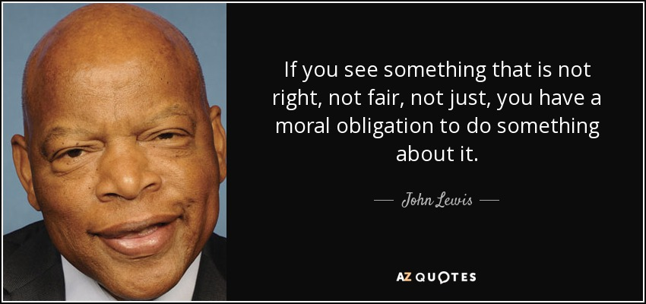
U.S. Representative John Lewis
1940-2020

Slide 22
Words of Wisdom: U.S. Rep. John Lewis
"These young people are saying we all have a right to know what is in the air we breathe, in the water we drink, and the food we eat. It is our responsibility to leave this planet cleaner and greener. That must be our legacy."
"Nothing can stop the power of a committed and determined people to make a difference in our society. Why? Because human beings are the most dynamic link to the divine on this planet."
"Get in good trouble, necessary trouble, and help redeem the soul of America."
"The civil rights movement was based on faith. Many of us who were participants in this movement saw our involvement as an extension of our faith. We saw ourselves doing the work of the Almighty. Segregation and racial discrimination were not in keeping with our faith, so we had to do something."

Slide 23
Conclusion
Provide a brief summary of your presentation. Remind the audience what you covered in the previous slides.

Slide 25
Michael Gordon Senior Policy Advisor , New Jersey Department of Environmental Protection
Supports and develops Natural Resource Damage (NRD) programs and major NRD cases
Leader in creating NJ’s first in the nation Environmental Justice Law to protect overburdened communities from certain additional environmental impacts [https://www.nj.gov/governor/news/news/562020/20200918a.shtml]
Before joining the DEP, Michael was in private legal practice, concentrating in environmental, municipal, and constitutional law
Served as environmental attorney to the Ironbound community in Newark over the past thirty years on issues including dioxin contamination, garbage incineration, and hazardous waste cleanup.
A graduate of Columbia University and Rutgers Law School, he has taught at Montclair State, and Rutgers and Seton Hall Law Schools.
Among his many recognitions is a Lifetime Achievement Award for shaping Environmental Law in New Jersey from the New Jersey Law Journal.

Slide 26
Environmental Justice Resources
NJ Environmental Justice Legislation
https://www.nj.gov/governor/news/news/562020/20200918a.shtml
NJ Dept. of Environmental Protection
https://www.nj.gov/dep/ej/
NJ Environmental Justice Alliance
http://www.njeja.org
NJ SHINES – Elena Weissmann
https://www.njshines.org elena@votesolar.org
GreenFaith
https://www.greenfaith.org

Slide 27
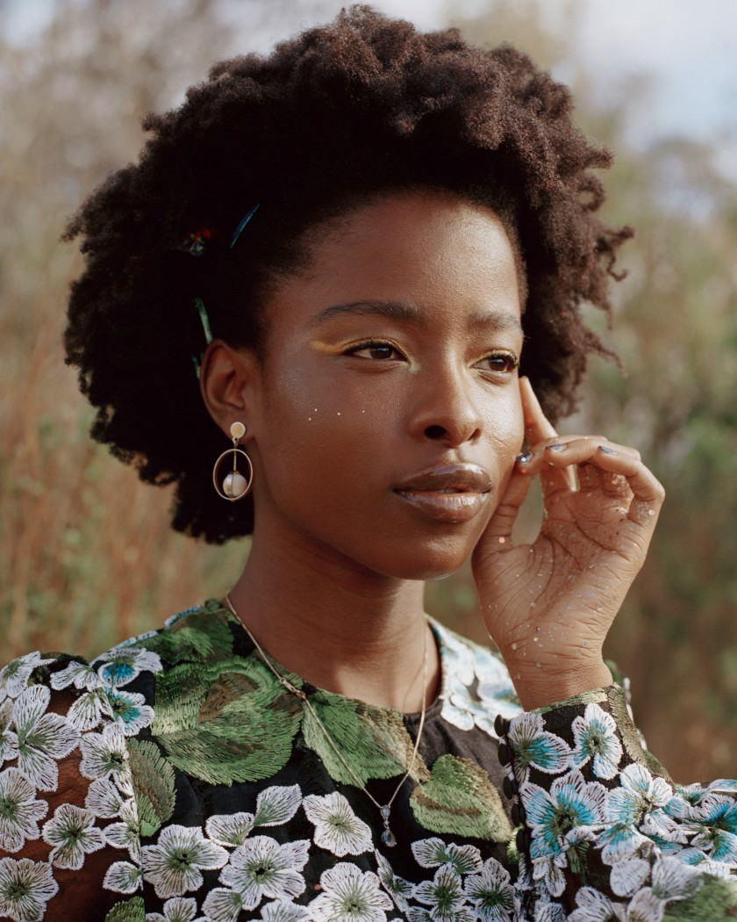
Amanda Gorman American Poet and Activist
Born 1998, Los Angeles, CA
Graduate of Harvard University
Member of St. Brigid Catholic Church
First National Youth Poet Laureate (2017-2018)
Her work focuses on issues of oppression, feminism, race, and marginalization, as well as the African diaspora
Published her poetry book The One for Whom Food Is Not Enough in 2015
In 2021, she delivered her poem "The Hill We Climb" at the inauguration of U.S. President Joe Biden

Slide 28
Words of Wisdom: Amanda Gorman
”The Hill We Climb”

Slide 29
THANK YOU!

