Slide 1
Welcome! Our program will begin promptly at 11:30 am

Slide 2
Still, We Rise Black History Month Event Feb. 12, 2023 St. Francis Episcopal Church

Slide 3
Today’s Program
Welcome & Opening Remarks – Heather Nunes, Chair St. Francis COME Committee
– Rillette Hammond, St. Francis COME Committee and Choir Member
“Lift Every Voice and Sing” – The St. Francis Choir
Spotlight on Carroll Wilson, a St. Francis Hero
– Princess Thomas, St. Francis COME Committee and Choir Member
Video – ”And Still, I Rise” – Maya Angelou
In Memoriam – Paul Sinckler, St. Francis Member
Celebrating the NAACP – Heather Nunes & Gabrielle Petit-Homme , St. Francis Member
Speaker Introduction – Ilia Scriven, St. Francis Treasurer
Keynote Address: ”Triumph in the Face of Adversity”
– Diane Hawkins, First Vice President of the NAACP New Brunswick Area Branch
Q&A – Christy McGuire/Heather Nunes, Moderators
Closing Remarks/Acknowledgements – Heather Nunes, Chair COME Committee
Closing Prayer – The Rev. Gerry Welch , St. Francis Deacon

Slide 4
“Lift Every Voice and Sing” The St. Francis Choir, Rachel Gastaya, Director Princess Thomas, Marie Petit-Homme, Rillette Hammond, & Grace McDougal
Often referred to as "The Negro National Anthem," Lift Every Voice and Sing was a hymn written as a poem by NAACP leader James Weldon Johnson in 1900. His brother, John Rosamond Johnson composed the music for the lyrics.
A choir of 500 schoolchildren at the school where James Weldon Johnson was principal first publicly performed the song to celebrate President Abraham Lincoln's birthday.

Slide 5
'THE NEGRO NATIONAL ANTHEM'
Lift every voice and sing Till earth and heaven ring, Ring with the harmonies of Liberty; Let our rejoicing rise High as the listening skies, Let it resound loud as the rolling sea. Sing a song full of the faith that the dark past has taught us, Sing a song full of the hope that the present has brought us, Facing the rising sun of our new day begun Let us march on till victory is won.
God of our weary years, God of our silent tears, Thou who has brought us thus far on the way; Thou who has by Thy might Led us into the light, Keep us forever in the path, we pray. Lest our feet stray from the places, Our God, where we met Thee; Lest, our hearts drunk with the wine of the world, we forget Thee; Shadowed beneath Thy hand, May we forever stand. True to our GOD, True to our native land
Stony the road we trod, Bitter the chastening rod, Felt in the days when hope unborn had died; Yet with a steady beat, Have not our weary feet Come to the place for which our fathers sighed? We have come over a way that with tears have been watered, We have come, treading our path through the blood of the slaughtered, Out from the gloomy past, Till now we stand at last Where the white gleam of our bright star is cast.

Slide 6
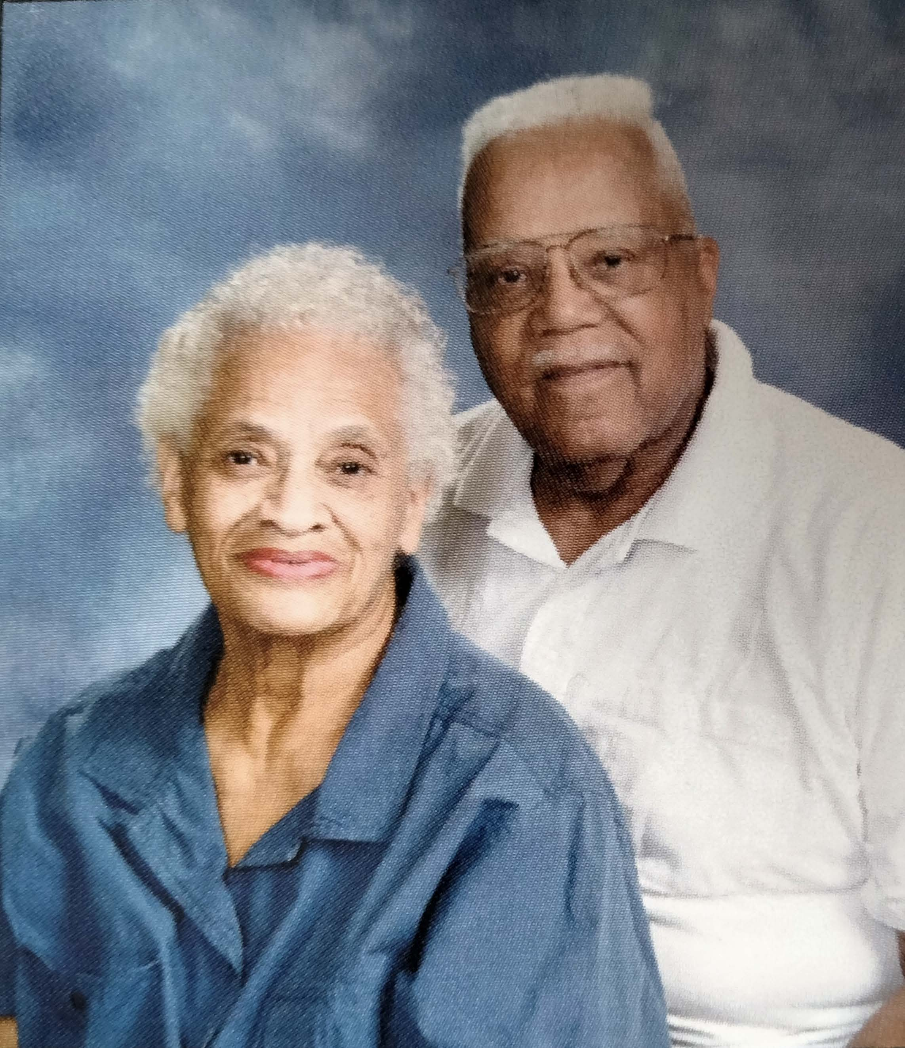
Spotlight on Carroll C. Wilson Trailblazer, Leader, Mentor
Married to Muriel, the love of his life, for over 63 years until her death in 2021. Together raised their four children Cheryle, Denise, Carroll Jr., and Martin
Member of St. Francis Episcopal Church for 40+ years
Served on the Vestry for many years; was a member of numerous, varied committees; and was a warm, welcoming usher and reader at early Sunday services
Carroll worked with the federal government for many years, culminating in the position of a Labor Relations Officer in the Office of Personnel Management
Army Veteran
Served in the Korean War
Rose to the rank of Captain in an all-white troop, and retired as a Colonel from the Army Reserves after 30 years of service
Carroll & Muriel - 2014
Thank you, Carroll! We salute you!

Slide 7
Maya Angelou ”And Still, I Rise”

Slide 8
In Memoriam
We wish to recognize and honor those who we have lost in the past year, people who have inspired us, entertained us, challenged us and made an impact not just on Black History, but Human History.

Slide 9
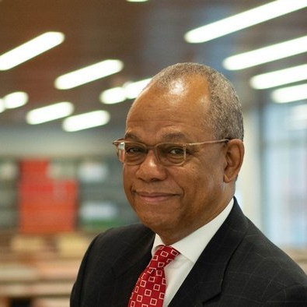
Remembering Rev. Dr. Calvin Butts III Changemaker, Visionary
1949-2022
Today’s program is dedicated to the memory of
Rev. Dr. Calvin Butts III, Pastor-Abyssinian Baptist Church, Harlem NY.
Rev. Butts served as Pastor of the globally renowned Abyssinian Baptist Church for more than 30 years where education and faith were the hallmarks of his ministry.
A powerful preacher, a leader devoted to positively uplifting the black community, and an effective voice for civil rights.
Rev. Butts founded the Abyssinian Development Corp. to redevelop the areas around the church with retail and residential buildings. Its stated mission was to "rebuild Harlem, brick by brick, block by block."

Slide 10
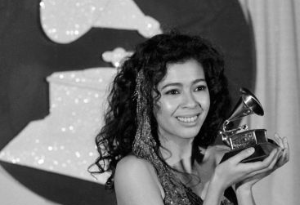
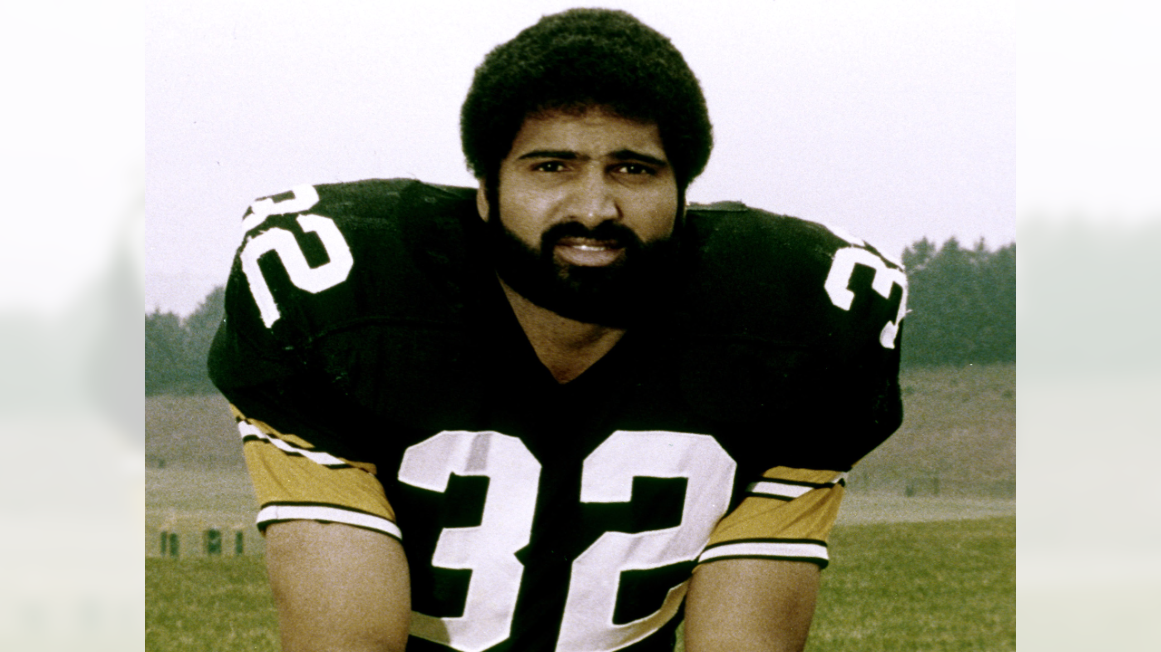
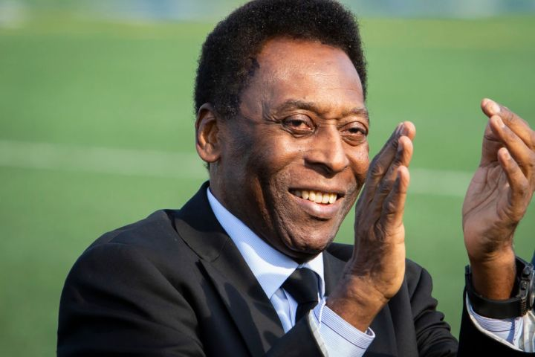
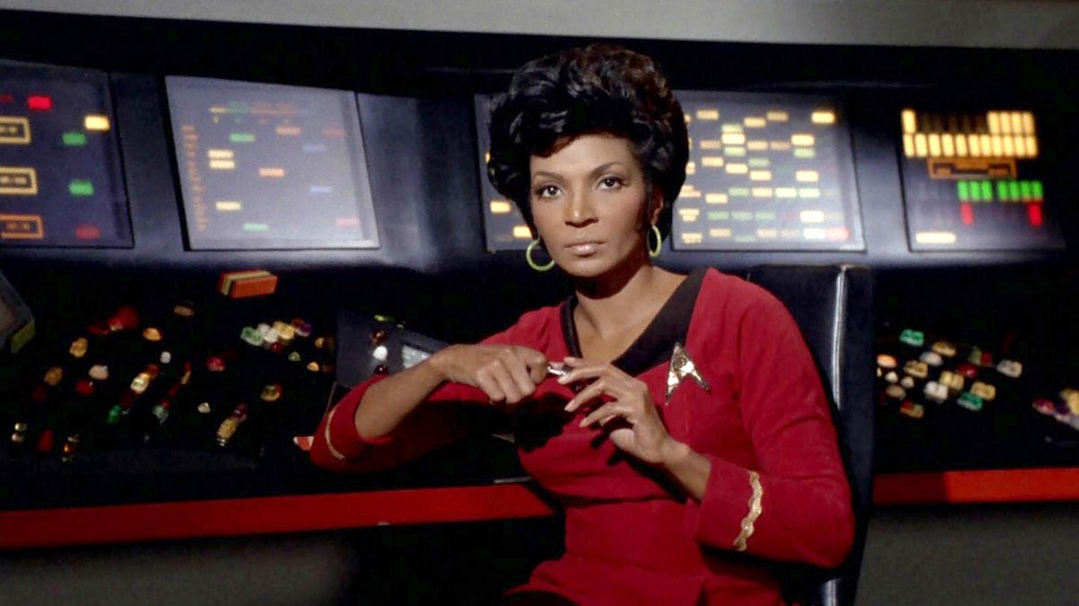
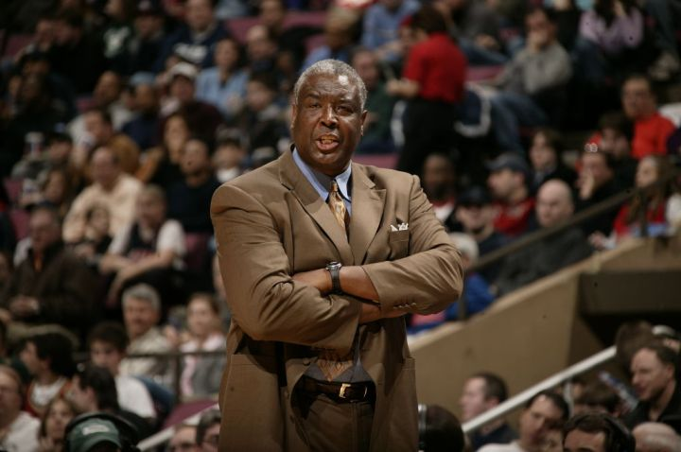
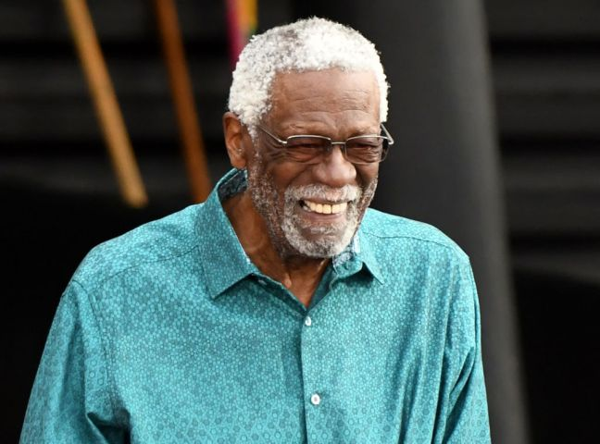
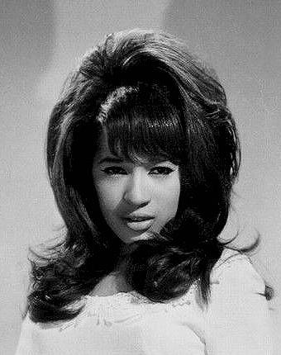
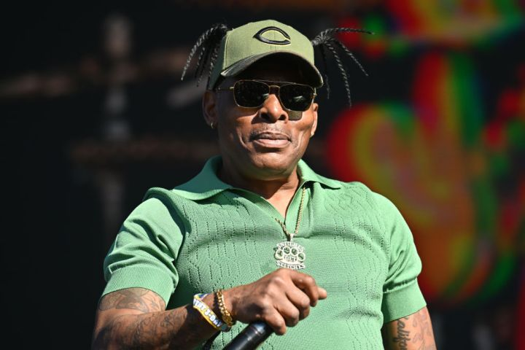
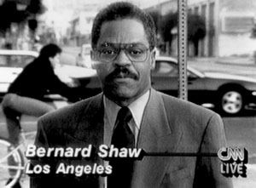
Athletes
Pele
Marion Barber III
Jaylon Ferguson
Johnny Grier
Franco Harris
Bob Lanier
Bill Russell
Paul Silas
Entertainers
Stephen “Twitch” Boss
Irene Cara
Coolio
Nichelle Nichols
Anita Pointer
Bernard Shaw
Ronnie Spector

Slide 11
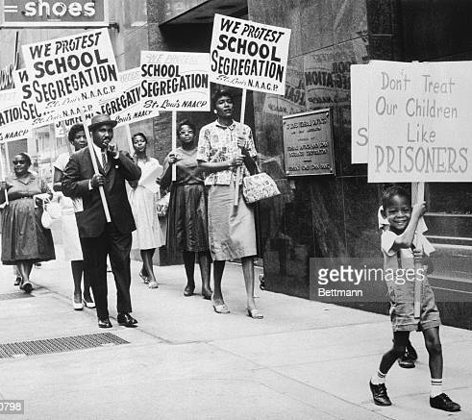
National Association for the Advancement of Colored People 114 years of Social Justice reform
Established on February 12th, 1909, in NYC by white & black activists due to on-going violence against African Americans. Happy Birthday!
Notable founders included Ida Wells Barnett, Mary White-Ovington, WEB Dubois and Henry Moskowitz.
The oldest and most recognized civil rights organization in the US.
Its aim was to secure for all people the rights guaranteed in the 13th, 14th, and 15th Amendments to the US Constitution which promised an end to slavery, provided equal protection under the law, and the right for all men to vote.

Slide 12
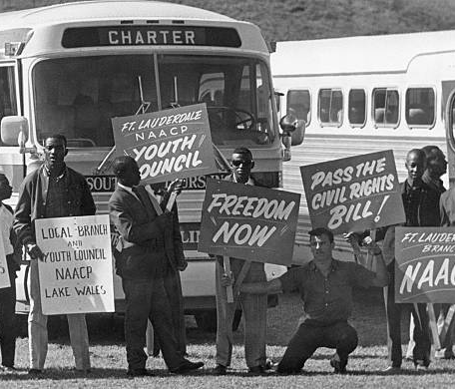
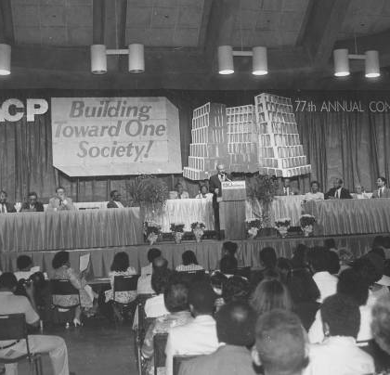
Accomplishments
In its early years, the NAACP focused its energies on disenfranchisement and racial segregation.
Fought the epidemic of the lynching of blacks by working for legislation, lobbying, and educating the public in the 1920’s & 1930’s
During the 1950’s, the NAACP, spearheaded by Thurgood Marshall, secured the last goals of ending segregation through Brown vs. Board of Education.
Assisted in passage of the Voting Rights Act (1965), the Civil Rights Act (1967), and the Fair Housing Act (1968).
Worked to oppose the apartheid policies in South Africa during the 1980’s.
In the late 1990s, the organization’s National Voter Fund launched its first major get-out-the-vote offensive and continues these efforts today
By failing to pass the legislation, you're passing

Slide 13
NAACP Today
Ensure that Black lives are a priority in all spaces
Race & Justice
Inclusive Economy
Advocacy & Litigation
Education Innovation
Health & Well-being
Environmental & Climate Justice
Next Generation Leadership
Our mission is to achieve equity, political rights, and social inclusion by advancing policies and practices that expand human and civil rights, eliminate discrimination, and accelerate the well-being, education, and economic security of Black people and all persons of color.
Today’s NAACP is powered by well over 2 million activists and more than 2,200 chapters across the nation,
including 41 chapters in New Jersey!
www.naacp.org

Slide 14
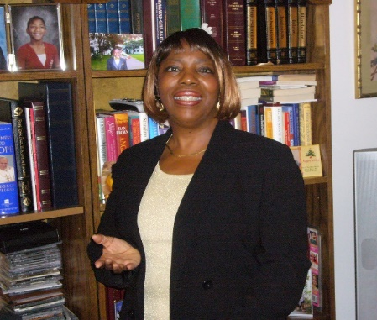
Diane Hawkins “Triumph in the Face of Adversity”
Diane is a Life Member of the NAACP, joining in 1982. She serves as the 1st Vice President of the New Brunswick Area Branch that serves 14 municipalities within Middlesex/Somerset Counties.
She’s the Housing Chair and travels the State addressing Affordable and Fair Share housing issues, meeting with HUD, the Division on Civil Rights, and other Stakeholders.
She also serves as Chair of the Religious Affairs and is a former member of the Environmental Climate Justice Sub-Committee on Housing, Parks & Open Spaces for the NJ State Conference NAACP.
Diane is a former Adjunct Professor in the Graduate Program at the New School for Social Research, in NYC. She enjoyed a 25+ year distinguished career at AT&T Long Lines and in Finance.

Slide 15
Q & A

Slide 16
“By failing to pass the legislation, you're passing on your sworn duty to protect the people. We can name all the victims of police violence, but we can't name a single law you have passed to address it. Tell us what you're going to do to honor Tyre Nichols."
- Derrick Johnson, President and CEO, NAACP
Demand that Congress pass the
George Floyd Justice in Policing Act
Tyre Nichols: June 5, 1993 – January 10, 2023
Father. Son. Brother.
Young-man. Black-man. Hu-man.

Slide 17
Thank You & Acknowledgements
Many thanks to…
Our guest, Diane Hawkins, for her insights and inspiration
The Vestry and parishioners of St. Francis for their help and support
BHM and COME Committees members
as well as our Choir, Deacon Gerry, and Technical Crew (Christy, Emma, Vincent)
Go Team!!

